Slide 1
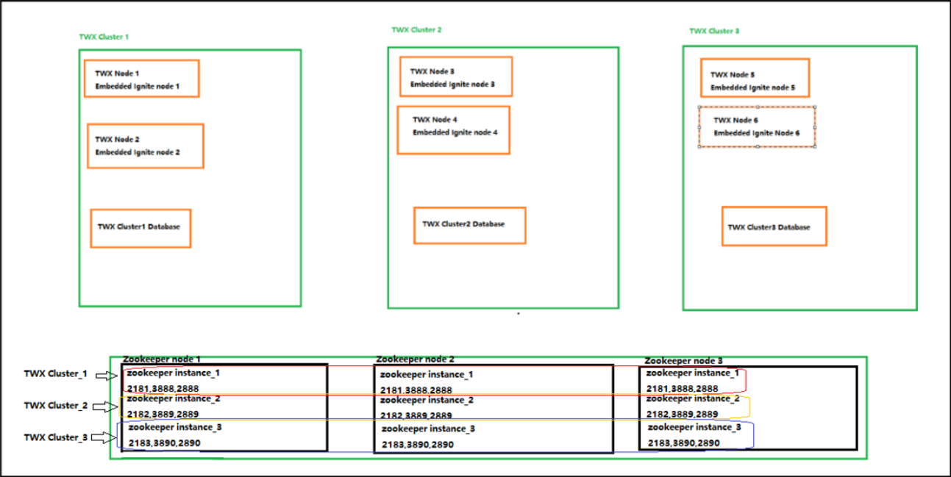
ZooKeeper Install
1. Zookeeper 압축 풀기, JDK 설치
sudo rpm -i java-11-amazon-corretto-devel-11.0.12.7-1.x86_64.rpm
cd /data001/download
tar xvf apache-zookeeper-3.7.0-bin.tar.gz
cd apache-zookeeper-3.7.0-bin
sudo mkdir -p /engn001/zookeeper
(zookeeper2,zookeeper3)
sudo cp -Rf * /engn001/zookeeper
(zookeeper2,zookeeper3)
sudo chown -Rf eiot_adm01:eiot_adm01 /engn001/zookeeper
(zookeeper2,zookeeper3)
cd /engn001/zookeeper/conf
(zookeeper2,zookeeper3)
sudo cp zoo_sample.cfg zoo.cfg
sudo mkdir -p /data001/zookeeper/data
(data2,data3)
sudo chown -Rf eiot_adm01:eiot_adm01 /data001/zookeeper
한 대의 zookeeper 서버에 3개 zookeeper instance를 설치
서버에 3개의 Zookeeper Instance를 설치한다고 치면, 예를 들어 아래와 같이 port를 지정합니다.
1) Zookeeper Instance_1은: 2181, 2888, 3888
2) Zookeeper Instance_2는: 2182, 2889, 3889
3) Zookeeper Instance_3은: 2183, 2890, 3890

Slide 2
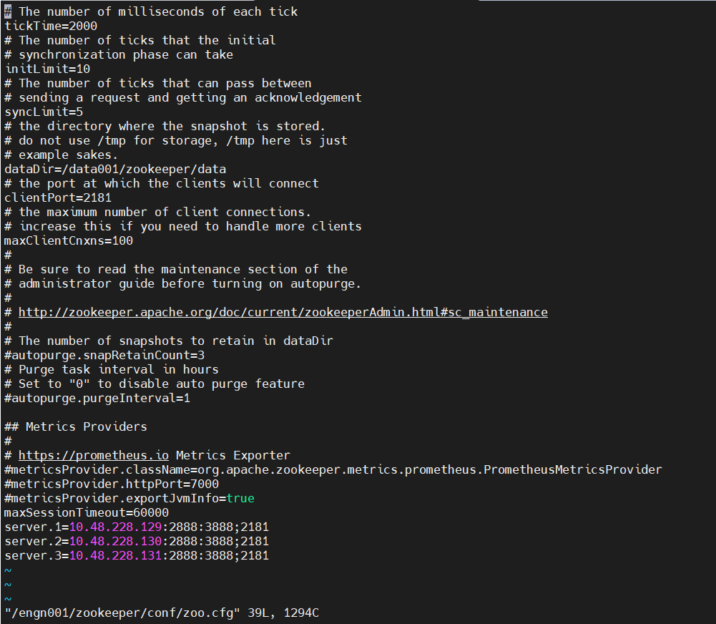
ZooKeeper Install
2. Zookeeper instance1 cfg 파일 설정
sudo vi /engn001/zookeeper/conf/zoo.cfg
# The number of milliseconds of each tick
tickTime=2000
# The number of ticks that the initial
# synchronization phase can take
initLimit=10
# The number of ticks that can pass between
# sending a request and getting an acknowledgement
syncLimit=5
# the directory where the snapshot is stored.
# do not use /tmp for storage, /tmp here is just
# example sakes.
dataDir=/data001/zookeeper/data
# the port at which the clients will connect
clientPort=2181
# the maximum number of client connections.
# increase this if you need to handle more clients
maxClientCnxns=100
#
# Be sure to read the maintenance section of the
# administrator guide before turning on autopurge.
#
# http://zookeeper.apache.org/doc/current/zookeeperAdmin.html#sc_maintenance
#
# The number of snapshots to retain in dataDir
#autopurge.snapRetainCount=3
# Purge task interval in hours
# Set to "0" to disable auto purge feature
#autopurge.purgeInterval=1
## Metrics Providers
#
# https://prometheus.io Metrics Exporter
#metricsProvider.className=org.apache.zookeeper.metrics.prometheus.PrometheusMetricsProvider
#metricsProvider.httpPort=7000
#metricsProvider.exportJvmInfo=true
maxSessionTimeout=60000
server.1=10.48.228.129:2888:3888;2181
server.2=10.48.228.130:2888:3888;2181
server.3=10.48.228.131:2888:3888;2181
Data 경로
Zookeeper 아이피

Slide 3
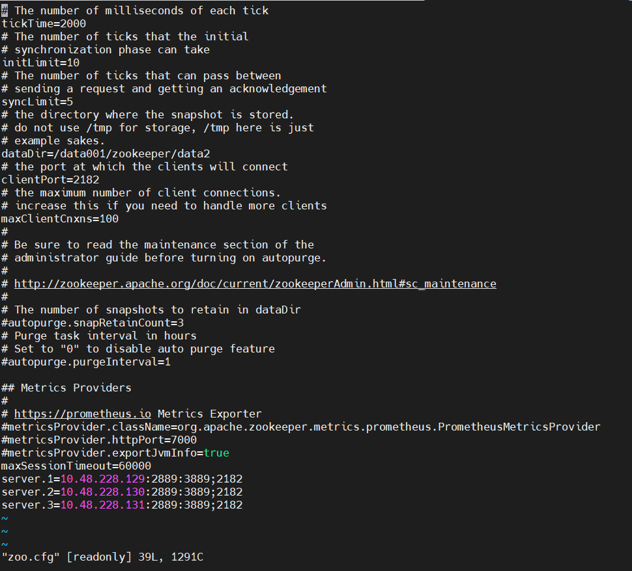
ZooKeeper Install
2. Zookeeper instance2 cfg 파일 설정
sudo vi /engn001/zookeeper/conf/zoo.cfg
# The number of milliseconds of each tick
tickTime=2000
# The number of ticks that the initial
# synchronization phase can take
initLimit=10
# The number of ticks that can pass between
# sending a request and getting an acknowledgement
syncLimit=5
# the directory where the snapshot is stored.
# do not use /tmp for storage, /tmp here is just
# example sakes.
dataDir=/data001/zookeeper/data2
# the port at which the clients will connect
clientPort=2182
# the maximum number of client connections.
# increase this if you need to handle more clients
maxClientCnxns=100
#
# Be sure to read the maintenance section of the
# administrator guide before turning on autopurge.
#
# http://zookeeper.apache.org/doc/current/zookeeperAdmin.html#sc_maintenance
#
# The number of snapshots to retain in dataDir
#autopurge.snapRetainCount=3
# Purge task interval in hours
# Set to "0" to disable auto purge feature
#autopurge.purgeInterval=1
## Metrics Providers
#
# https://prometheus.io Metrics Exporter
#metricsProvider.className=org.apache.zookeeper.metrics.prometheus.PrometheusMetricsProvider
#metricsProvider.httpPort=7000
#metricsProvider.exportJvmInfo=true
maxSessionTimeout=60000
server.1=10.48.228.129:2889:3889;2182
server.2=10.48.228.130:2889:3889;2182
server.3=10.48.228.131:2889:3889;2182
Data 경로
Zookeeper 아이피

Slide 4
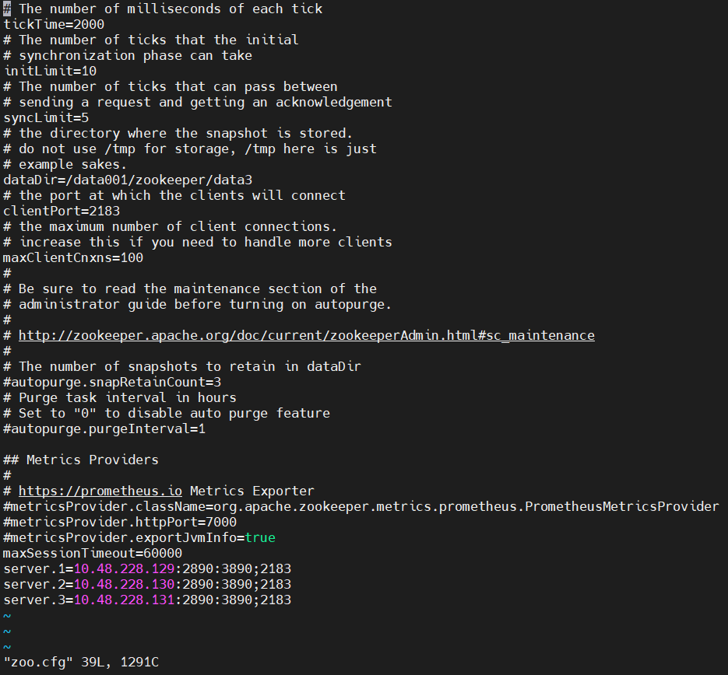
ZooKeeper Install
2. Zookeeper instance3 cfg 파일 설정
sudo vi /engn001/zookeeper/conf/zoo.cfg
# The number of milliseconds of each tick
tickTime=2000
# The number of ticks that the initial
# synchronization phase can take
initLimit=10
# The number of ticks that can pass between
# sending a request and getting an acknowledgement
syncLimit=5
# the directory where the snapshot is stored.
# do not use /tmp for storage, /tmp here is just
# example sakes.
dataDir=/data001/zookeeper/data3
# the port at which the clients will connect
clientPort=2183
# the maximum number of client connections.
# increase this if you need to handle more clients
maxClientCnxns=100
#
# Be sure to read the maintenance section of the
# administrator guide before turning on autopurge.
#
# http://zookeeper.apache.org/doc/current/zookeeperAdmin.html#sc_maintenance
#
# The number of snapshots to retain in dataDir
#autopurge.snapRetainCount=3
# Purge task interval in hours
# Set to "0" to disable auto purge feature
#autopurge.purgeInterval=1
## Metrics Providers
#
# https://prometheus.io Metrics Exporter
#metricsProvider.className=org.apache.zookeeper.metrics.prometheus.PrometheusMetricsProvider
#metricsProvider.httpPort=7000
#metricsProvider.exportJvmInfo=true
maxSessionTimeout=60000
server.1=10.48.228.129:2890:3890;2183
server.2=10.48.228.130:2890:3890;2183
server.3=10.48.228.131:2890:3890;2183
Data 경로
Zookeeper 아이피

Slide 5

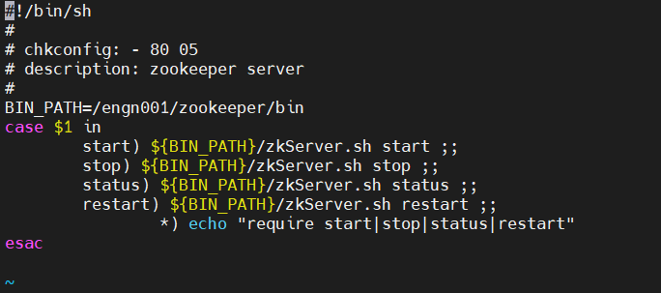
ZooKeeper Install
3. Zookeeper instance1 서비스 등록 및 시작
sudo vi /data001/zookeeper/data/myid
1
※myid는 zoo.cfg server.1,2,3 에 맞춰서 작성
sudo vi /etc/init.d/zookeeper-server
#!/bin/sh
#
# chkconfig: - 80 05
# description: zookeeper server
#
BIN_PATH=/engn001/zookeeper/bin
case $1 in
start) ${BIN_PATH}/zkServer.sh start ;;
stop) ${BIN_PATH}/zkServer.sh stop ;;
status) ${BIN_PATH}/zkServer.sh status ;;
restart) ${BIN_PATH}/zkServer.sh restart ;;
*) echo "require start|stop|status|restart"
esac
cd /etc/init.d
sudo chmod +x zookeeper-server
sudo chkconfig --add zookeeper-server
sudo chkconfig zookeeper-server on
sudo service zookeeper-server start
sudo service zookeeper-server status

Slide 6
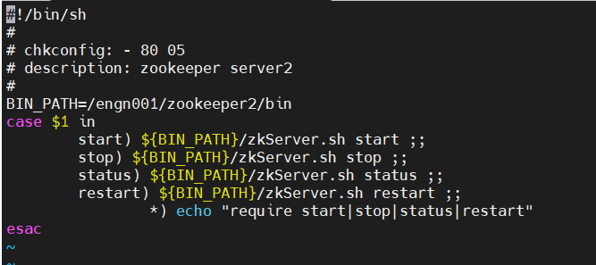
ZooKeeper Install
3. Zookeeper instance2 서비스 등록 및 시작
sudo vi /data001/zookeeper/data2/myid
1
※myid는 zoo.cfg server.1,2,3 에 맞춰서 작성
sudo vi /etc/init.d/zookeeper-server2
#!/bin/sh
#
# chkconfig: - 80 05
# description: zookeeper server
#
BIN_PATH=/engn001/zookeeper2/bin
case $1 in
start) ${BIN_PATH}/zkServer.sh start ;;
stop) ${BIN_PATH}/zkServer.sh stop ;;
status) ${BIN_PATH}/zkServer.sh status ;;
restart) ${BIN_PATH}/zkServer.sh restart ;;
*) echo "require start|stop|status|restart"
esac
cd /etc/init.d
sudo chmod +x zookeeper-server2
sudo chkconfig --add zookeeper-server2
sudo chkconfig zookeeper-server2 on
sudo service zookeeper-server2 start
sudo service zookeeper-server2 status

Slide 7
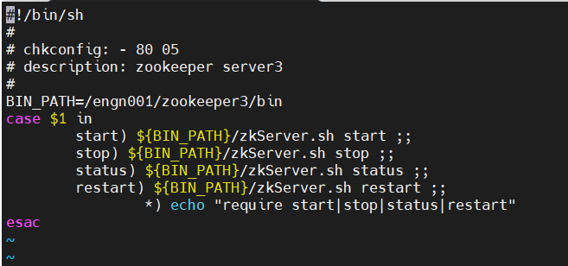
ZooKeeper Install
3. Zookeeper instance3 서비스 등록 및 시작
sudo vi /data001/zookeeper/data3/myid
1
※myid는 zoo.cfg server.1,2,3 에 맞춰서 작성
sudo vi /etc/init.d/zookeeper-server3
#!/bin/sh
#
# chkconfig: - 80 05
# description: zookeeper server
#
BIN_PATH=/engn001/zookeeper3/bin
case $1 in
start) ${BIN_PATH}/zkServer.sh start ;;
stop) ${BIN_PATH}/zkServer.sh stop ;;
status) ${BIN_PATH}/zkServer.sh status ;;
restart) ${BIN_PATH}/zkServer.sh restart ;;
*) echo "require start|stop|status|restart"
esac
cd /etc/init.d
sudo chmod +x zookeeper-server3
sudo chkconfig --add zookeeper-server3
sudo chkconfig zookeeper-server3 on
sudo service zookeeper-server3 start
sudo service zookeeper-server3 status

Slide 8
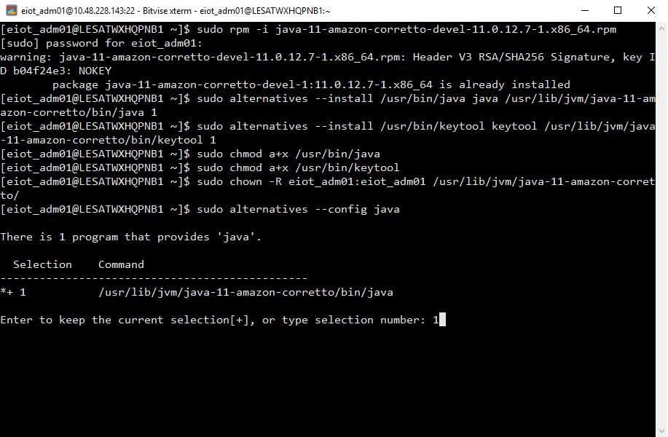
Thingworx 9.2 Install
1. OpenJDK 설치
1.자바 rpm 설치
sudo rpm -i java-11-amazon-corretto-devel-11.0.12.7-1.x86_64.rpm
2.심볼릭 링크 등록
sudo alternatives --install /usr/bin/java java /usr/lib/jvm/java-11-amazon-corretto/bin/java 1
sudo alternatives --install /usr/bin/keytool keytool /usr/lib/jvm/java-11-amazon-corretto/bin/keytool 1
3. 자바 권한
sudo chmod a+x /usr/bin/java
sudo chmod a+x /usr/bin/keytool
sudo chown -R eiot_adm01:eiot_adm01 /usr/lib/jvm/java-11-amazon-corretto/
4.자바 선택
sudo alternatives --config java

Slide 9
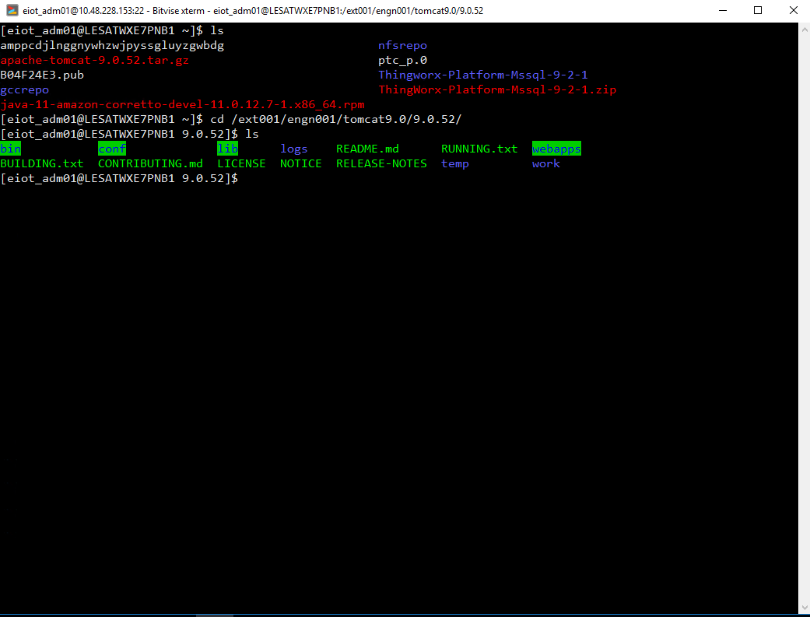
Thingworx 9.2 Install
2. Tomcat 설치
1.톰캣 압축 풀기
tar -xf apache-tomcat-9.0.52.tar.gz
2.톰캣 이동
sudo mkdir -p /ext001/engn001/tomcat9.0
sudo mv apache-tomcat-9.0.52 /ext001/engn001/tomcat9.0/9.0.52
sudo vi /etc/environment
export JAVA_HOME=/usr/lib/jvm/java-11-amazon-corretto
export CATALINA_HOME=/ext001/engn001/tomcat9.0/9.0.52
export THINGWORX_PLATFORM_SETTINGS=/ext001/data001/ThingworxPlatform
source /etc/environment
3. 톰캣 폴더로 이동
cd /ext001/engn001/tomcat9.0/9.0.52/

Slide 10
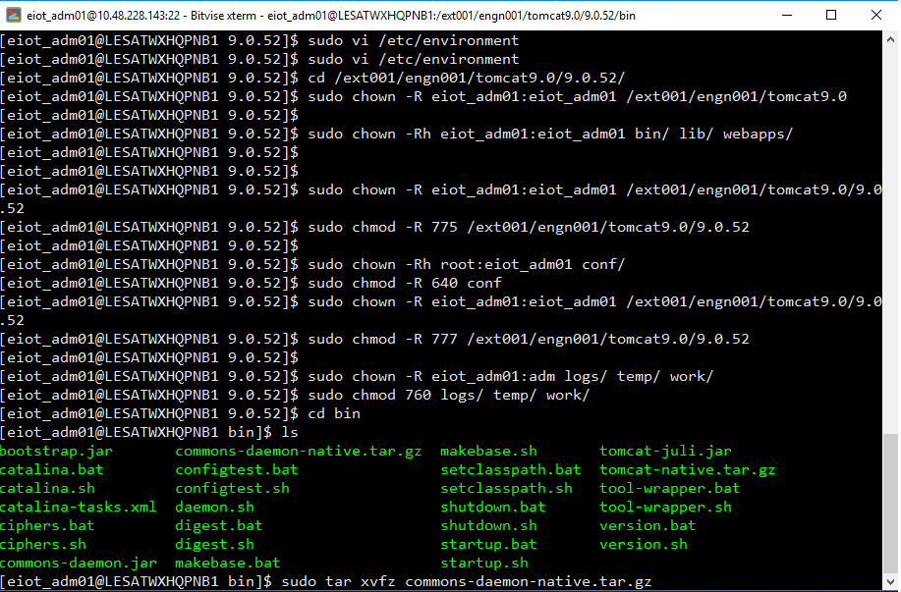
Thingworx 9.2 Install
2. Tomcat 설치
4.권한 설정
sudo chown -R eiot_adm01:eiot_adm01 /ext001/engn001/tomcat9.0
sudo chown -Rh eiot_adm01:eiot_adm01 bin/ lib/ webapps/
sudo chown -R eiot_adm01:eiot_adm01 /ext001/engn001/tomcat9.0/9.0.52
sudo chmod -R 775 /ext001/engn001/tomcat9.0/9.0.52
sudo chown -Rh eiot_adm01:eiot_adm01 conf/
sudo chmod -R 640 conf
sudo chown -R eiot_adm01:eiot_adm01 /ext001/engn001/tomcat9.0/9.0.52
sudo chmod -R 777 /ext001/engn001/tomcat9.0/9.0.52
sudo chown -R eiot_adm01:eiot_adm01 logs/ temp/ work/
sudo chmod 760 logs/ temp/ work/

Slide 11
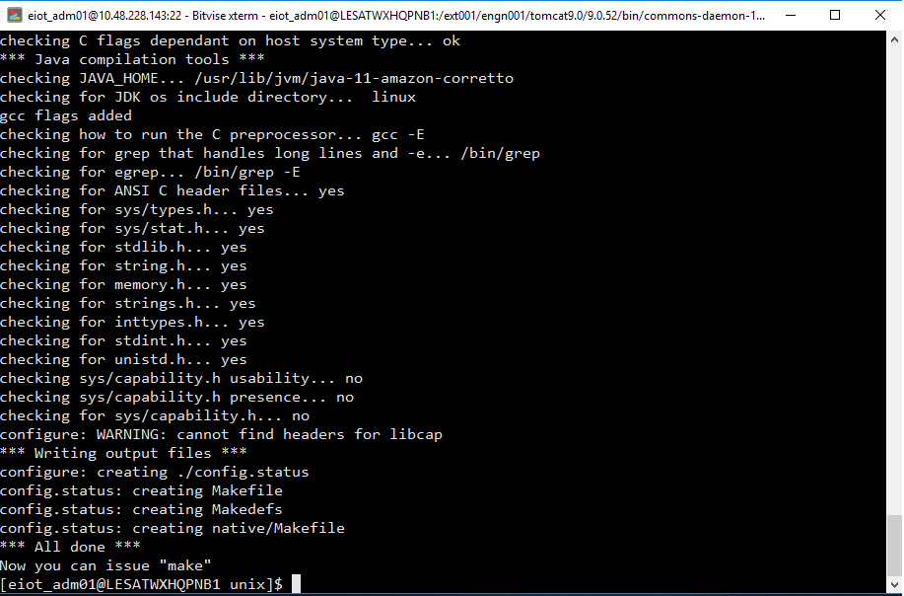
Thingworx 9.2 Install
2. Tomcat 설치
5.gcc 설치 ,데몬 설치
cd /home/eiot_adm01/gccrepo
sudo rpm -Uvh mpfr-3.1.1-4.el7.x86_64.rpm
sudo rpm -Uvh libmpc-1.0.1-3.el7.x86_64.rpm
sudo rpm -Uvh cpp-4.8.5-36.el7.x86_64.rpm
sudo rpm -Uvh kernel-headers-3.10.0-957.el7.x86_64.rpm
sudo rpm -Uvh glibc-headers-2.17-260.el7.x86_64.rpm
sudo rpm -Uvh glibc-devel-2.17-260.el7.x86_64.rpm
sudo rpm -Uvh gcc-4.8.5-36.el7.x86_64.rpm
cd /ext001/engn001/tomcat9.0/9.0.52/bin
sudo tar xvfz commons-daemon-native.tar.gz
cd commons-daemon-1.2.4-native-src/unix/
sudo ./configure --with-java=$JAVA_HOME
sudo make
sudo cp jsvc ../..
6. 톰캣 로그 폴더 생성
sudo mkdir -p /ext001/data001/TomcatLogs/logs
cd /ext001/data001
sudo chown -Rf eiot_adm01:eiot_adm01 TomcatLogs
sudo chmod 775 -Rf TomcatLogs

Slide 12
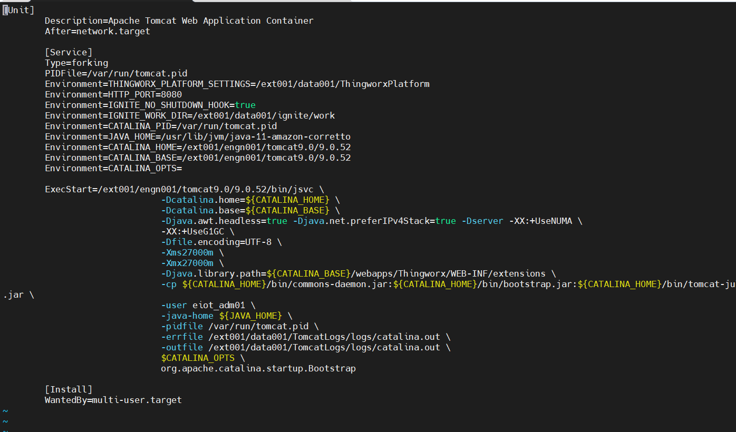
Thingworx 9.2 Install
2. Tomcat 설치
7. 톰캣 서비스 생성
sudo touch /usr/lib/systemd/system/tomcat.service
sudo vi /usr/lib/systemd/system/tomcat.service
Thingworx platform-settings.json 경로
[Unit]
Description=Apache Tomcat Web Application Container
After=network.target
[Service]
Type=forking
PIDFile=/var/run/tomcat.pid
Environment=THINGWORX_PLATFORM_SETTINGS=/ext001/data001/ThingworxPlatform
Environment=HTTP_PORT=8080
Environment=IGNITE_NO_SHUTDOWN_HOOK=true
Environment=IGNITE_WORK_DIR=/ext001/data001/ignite/work
Environment=CATALINA_PID=/var/run/tomcat.pid
Environment=JAVA_HOME=/usr/lib/jvm/java-11-amazon-corretto
Environment=CATALINA_HOME=/ext001/engn001/tomcat9.0/9.0.52
Environment=CATALINA_BASE=/ext001/engn001/tomcat9.0/9.0.52
Environment=CATALINA_OPTS=
ExecStart=/ext001/engn001/tomcat9.0/9.0.52/bin/jsvc \
-Dcatalina.home=${CATALINA_HOME} \
-Dcatalina.base=${CATALINA_BASE} \
-Djava.awt.headless=true -Djava.net.preferIPv4Stack=true -Dserver -XX:+UseNUMA \
-XX:+UseG1GC \
-Dfile.encoding=UTF-8 \
-Xms22000m \
-Xmx22000m \
-Djava.library.path=${CATALINA_BASE}/webapps/Thingworx/WEB-INF/extensions \
-cp ${CATALINA_HOME}/bin/commons-daemon.jar:${CATALINA_HOME}/bin/bootstrap.jar:${CATALINA_HOME}/bin/tomcat-juli.jar \
-user eiot_adm01 \
-java-home ${JAVA_HOME} \
-pidfile /var/run/tomcat.pid \
-errfile /ext001/data001/TomcatLogs/logs/catalina.out \
-outfile /ext001/data001/TomcatLogs/logs/catalina.out \
$CATALINA_OPTS \
org.apache.catalina.startup.Bootstrap
[Install]
WantedBy=multi-user.target
Ignite work 경로
메모리의 70%
로그 경로

Slide 13
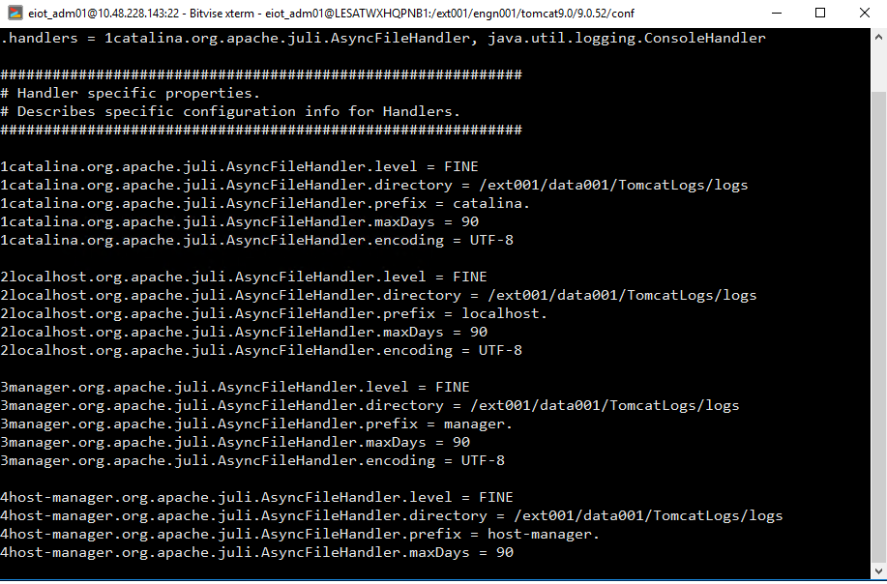
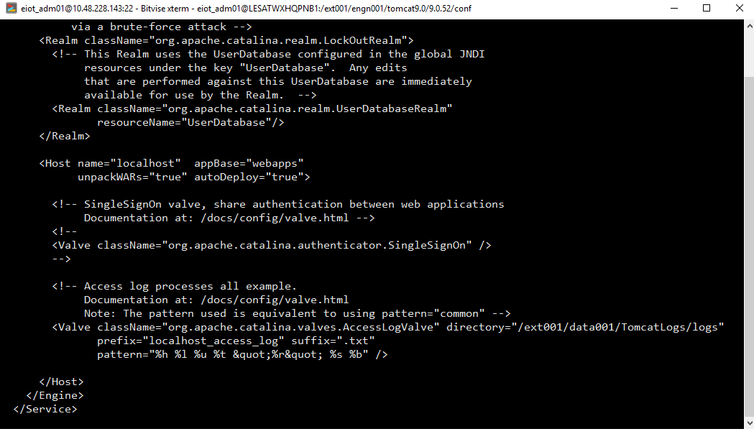
Thingworx 9.2 Install
2. Tomcat 설치
8. 톰캣 로그 경로 설정
cd /ext001/engn001/tomcat9.0/9.0.52/conf
cp logging.properties logging.properties_org
vi logging.properties
cp server.xml server.xml_org
vi server.xml

Slide 14
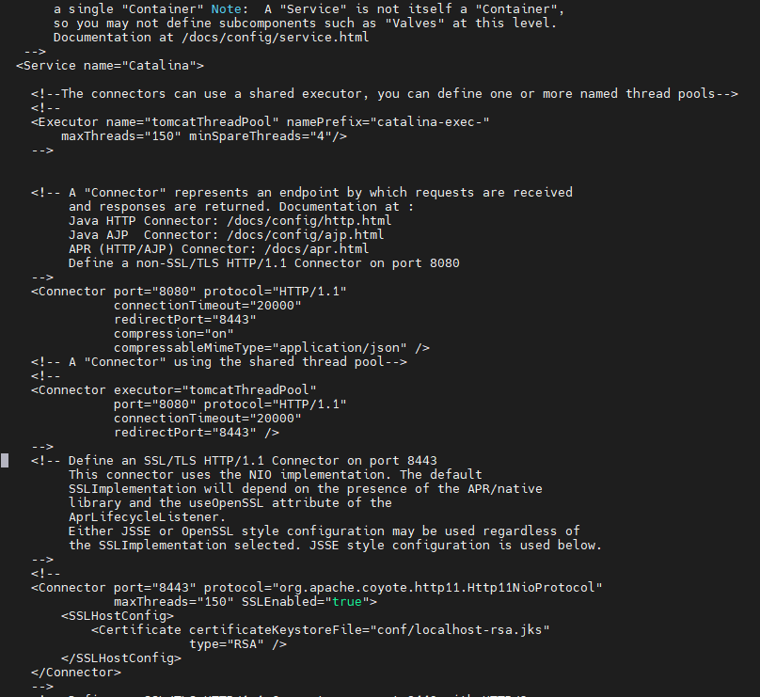
Thingworx 9.2 Install
2. Tomcat 설치
9. 톰캣 압축 활성화 설정
<Connector port="8080" protocol="HTTP/1.1"
connectionTimeout="20000"
redirectPort="8443"
compression="on"
compressableMimeType="application/json" />

Slide 15
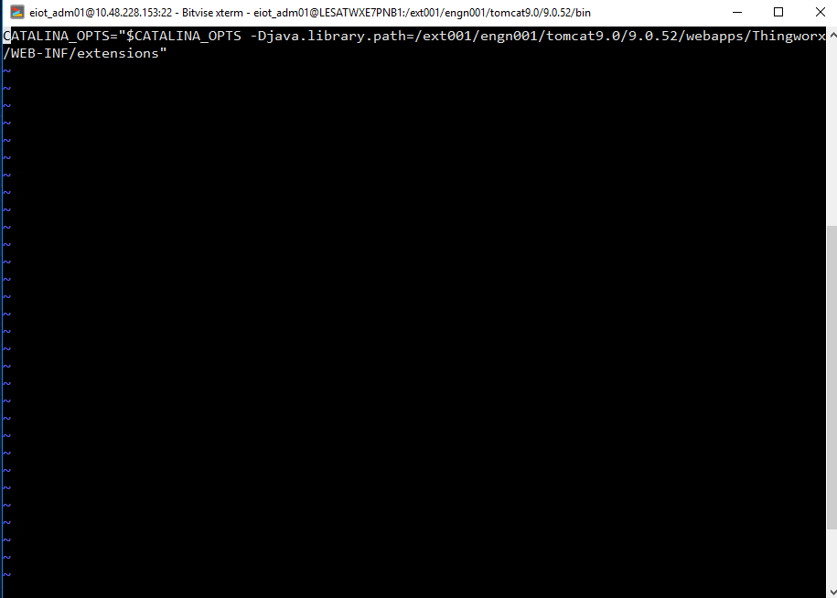
Thingworx 9.2 Install
2. Tomcat 설치
10. 톰캣 setenv.sh 파일 설정
cd /ext001/engn001/tomcat9.0/9.0.52/bin
sudo touch setenv.sh
sudo chown eiot_adm01:eiot_adm01 /ext001/engn001/tomcat9.0/9.0.52/bin/setenv.sh
sudo chmod 775 /ext001/engn001/tomcat9.0/9.0.52/bin/setenv.sh
sudo vi setenv.sh
CATALINA_OPTS="$CATALINA_OPTS -Djava.library.path=/ext001/engn001/tomcat9.0/9.0.52/webapps/Thingworx/WEB-INF/extensions"

Slide 16
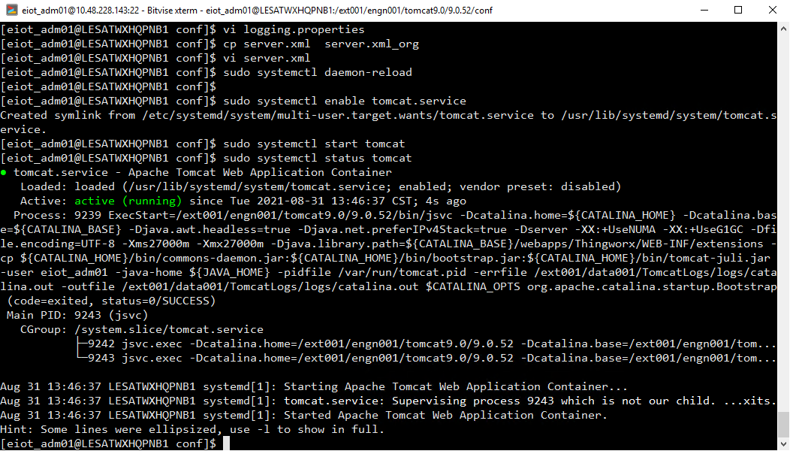
Thingworx 9.2 Install
2. Tomcat 설치
11. 톰캣 서비스 등록 및 시작
sudo systemctl daemon-reload
sudo systemctl enable tomcat.service
sudo systemctl start tomcat
sudo systemctl stop tomcat
sudo systemctl restart tomcat
sudo systemctl status tomcat

Slide 17
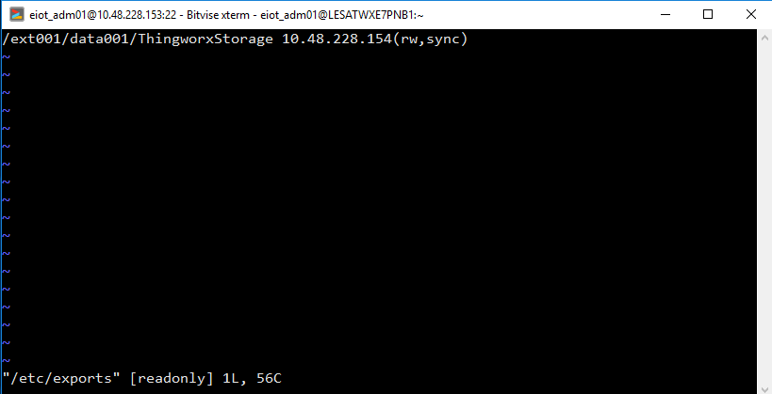
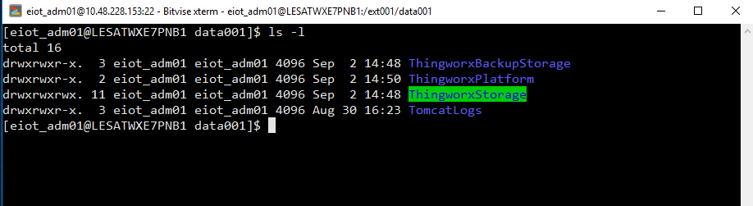
Thingworx 9.2 Install
3. Thingworx 설치
1. Thingworx 폴더 생성
cd /ext001/data001
sudo mkdir ThingworxStorage ThingworxBackupStorage ThingworxPlatform
sudo chown eiot_adm01:eiot_adm01 ThingworxStorage ThingworxBackupStorage ThingworxPlatform
sudo chmod 775 ThingworxStorage ThingworxBackupStorage ThingworxPlatform
NFS 서비스 설치 #1,#2번 서버 둘다 설치
cd /home/eiot_adm01/nfsrepo
sudo rpm -Uvh --replacepkgs *.rpm
NFS 공유할 폴더 설정 #1번 서버만 세팅
sudo vi /etc/exports #1번 서버만 세팅
/ext001/data001/ThingworxStorage 10.48.228.154(rw,sync) #1번 서버만 세팅
공유 폴더 경로 설정
공유받을 아이피 및 권한

Slide 18
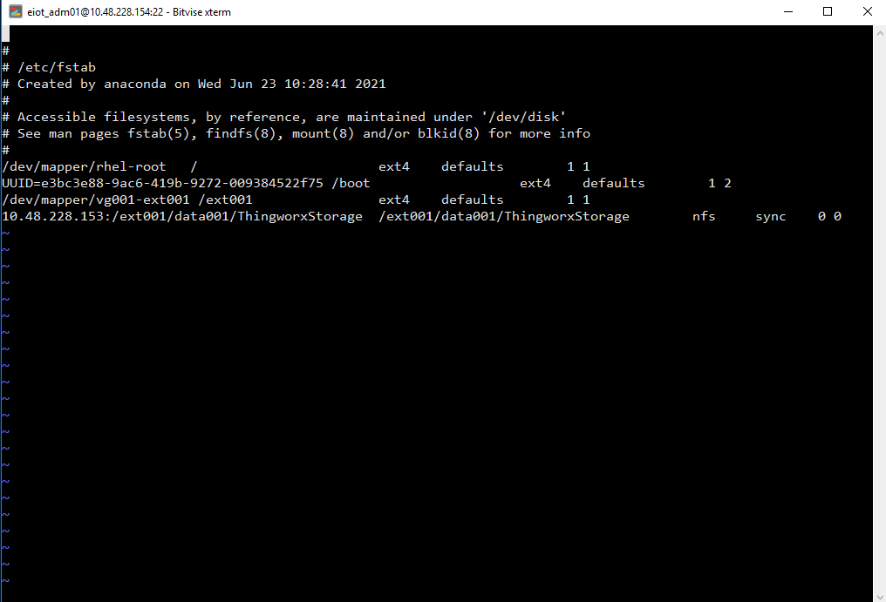
Thingworx 9.2 Install
3. Thingworx 설치
#1번 서버 nfs 서비스 실행
sudo systemctl daemon-reload
sudo systemctl start nfs
sudo systemctl enable nfs
#2번 서버 rpcbind 실행
sudo systemctl daemon-reload
sudo systemctl start rpcbind
sudo systemctl enable rpcbind
3. Thingworx Storage 클라이언트 부팅시 자동마운트 설정 #2번 서버만 세팅
sudo vi /etc/fstab에 아래 내용 작성 #2번 서버만 세팅
10.48.228.153:/ext001/data001/ThingworxStorage /ext001/data001/ThingworxStorage nfs sync 0 0
sudo mount –t nfs 10.48.228.153:/ext001/data001/ThingworxStorage /ext001/data001/ThingworxStorage #2번 서버만 세팅
공유 폴더 경로

Slide 19
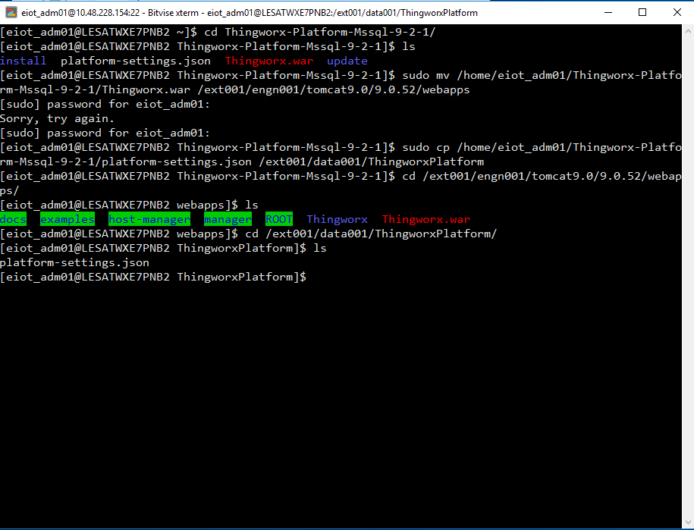
Thingworx 9.2 Install
3. Thingworx 설치
4. Thingworx 파일 이동
sudo mv /home/eiot_adm01/Thingworx-Platform-Mssql-9-2-1/Thingworx.war /ext001/engn001/tomcat9.0/9.0.52/webapps
sudo cp /home/eiot_adm01/Thingworx-Platform-Mssql-9-2-1/platform-settings.json /ext001/data001/ThingworxPlatform
5. Thingworx 파일 권한
sudo chown eiot_adm01:eiot_adm01 /ext001/data001/ThingworxPlatform/platform-settings.json
sudo chmod 775 /ext001/data001/ThingworxPlatform/platform-settings.json
sudo mkdir -p /ext001/data001/ignite/work
sudo chown -Rf eiot_adm01:eiot_adm01 /ext001/data001/ignite

Slide 20
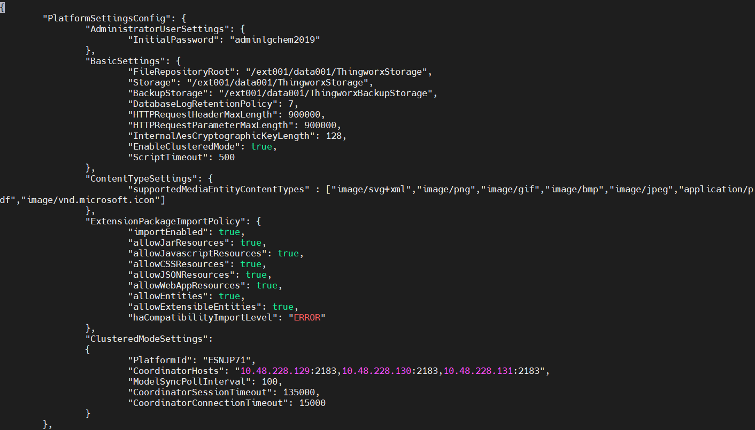
Thingworx 9.2 Install
3. Thingworx 설치
6. platform-settings.json 파일 설정
sudo vi /ext001/data001/ThingworxPlatform/platform-settings.json
{
"PlatformSettingsConfig": {
"AdministratorUserSettings": {
"InitialPassword": "adminlgchem2019"
},"BasicSettings": {
"FileRepositoryRoot": "/ext001/data001/ThingworxStorage",
"Storage": "/ext001/data001/ThingworxStorage",
"BackupStorage": "/ext001/data001/ThingworxBackupStorage",
"DatabaseLogRetentionPolicy": 7,
"HTTPRequestHeaderMaxLength": 900000,
"HTTPRequestParameterMaxLength": 900000,
"InternalAesCryptographicKeyLength": 128,
"EnableClusteredMode": true,
"ScriptTimeout" : 500
},"ContentTypeSettings": {"supportedMediaEntityContentTypes" : ["image/svg+xml","image/png","image/gif","image/bmp","image/jpeg","application/pdf","image/vnd.microsoft.icon"]},
"ExtensionPackageImportPolicy": {
"importEnabled": true,
"allowJarResources": true,
"allowJavascriptResources": true,
"allowCSSResources": true,
"allowJSONResources": true,
"allowWebAppResources": true,
"allowEntities": true,
"allowExtensibleEntities": true,
"haCompatibilityImportLevel": “ERROR"
} ,"ClusteredModeSettings":
{ "PlatformId": "ESNJP71", "CoordinatorHosts": "10.48.228.129:2181,10.48.228.130:2181,10.48.228.131:2181",
"ModelSyncPollInterval": 100,
"CoordinatorSessionTimeout": 135000,
"CoordinatorConnectionTimeout": 15000
}
},
폴더 경로 설정
Zookeeper IP 및 포트 설정, Timeout 설정
TWX별 개별 명칭

Slide 21
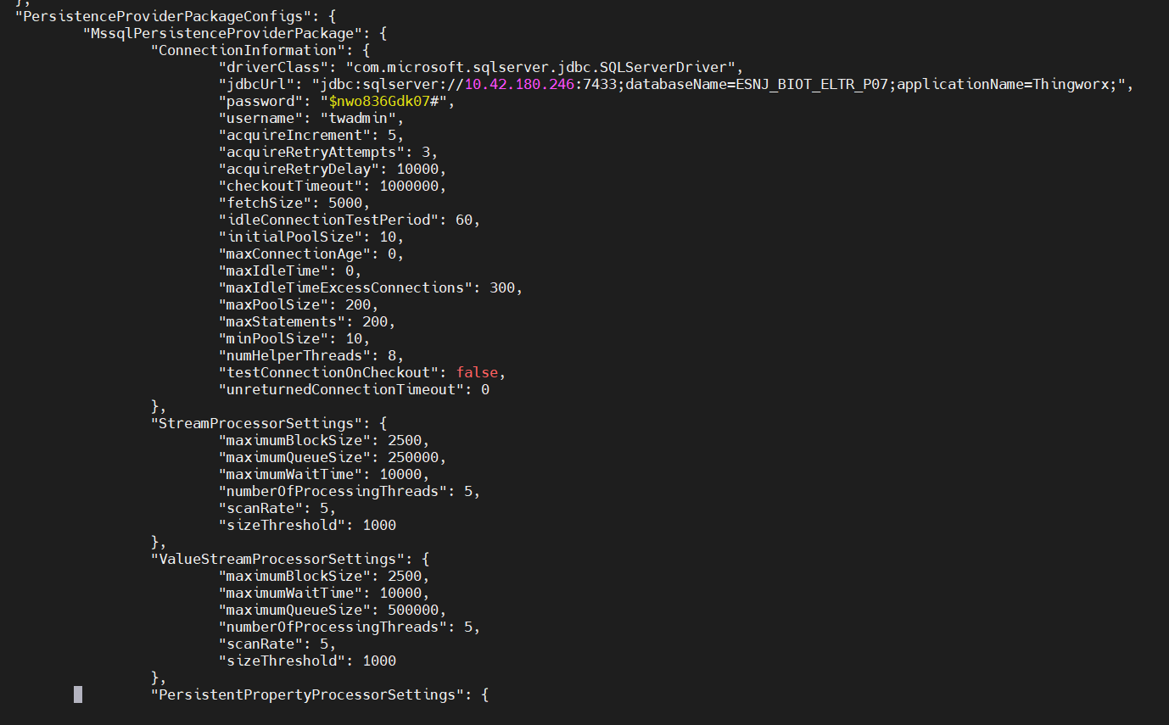
Thingworx 9.2 Install
3. Thingworx 설치
"PersistenceProviderPackageConfigs": {
"MssqlPersistenceProviderPackage": {
"ConnectionInformation": {
"driverClass": "com.microsoft.sqlserver.jdbc.SQLServerDriver",
"jdbcUrl":"jdbc:sqlserver://10.42.180.246:7433;databaseName=ESNJ_BIOT_ELTR_P07;applicationName=Thingworx;",
"password": "$nwo836Gdk07#",
"username": "twadmin",
"acquireIncrement": 5,
"acquireRetryAttempts": 3,
"acquireRetryDelay": 10000,
"checkoutTimeout": 1000000,
"fetchSize": 5000,
"idleConnectionTestPeriod": 60,
"initialPoolSize": 10,
"maxConnectionAge": 0,
"maxIdleTime": 0,
"maxIdleTimeExcessConnections": 300,
"maxPoolSize": 200,
"maxStatements": 200,
"minPoolSize": 10,
"numHelperThreads": 8,
"testConnectionOnCheckout": false,
"unreturnedConnectionTimeout": 0
}, "StreamProcessorSettings": {
"maximumBlockSize": 2500,
"maximumQueueSize": 250000,
"maximumWaitTime": 10000,
"numberOfProcessingThreads": 5,
"scanRate": 5,
"sizeThreshold": 1000
},
"ValueStreamProcessorSettings": {
"maximumBlockSize": 2500,
"maximumWaitTime": 10000,
"maximumQueueSize": 500000,
"numberOfProcessingThreads": 5,
"scanRate": 5,
"sizeThreshold": 1000
},
DB 이름 ,유저 ,패스워드 입력

Slide 22
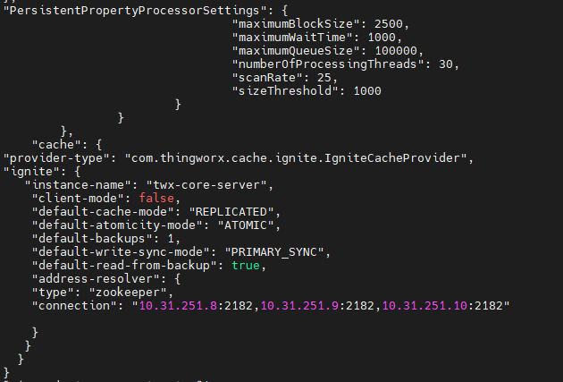
Thingworx 9.2 Install
3. Thingworx 설치
"PersistentPropertyProcessorSettings": {
"maximumBlockSize": 2500,
"maximumWaitTime": 1000,
"maximumQueueSize": 100000,
"numberOfProcessingThreads": 30,
"scanRate": 25,
"sizeThreshold": 1000
}
}
},
"cache": {
"provider-type": "com.thingworx.cache.ignite.IgniteCacheProvider",
"ignite": {
"instance-name": "twx-core-server",
"client-mode": false,
"default-cache-mode": "REPLICATED",
"default-atomicity-mode": "ATOMIC",
"default-backups": 1,
"default-write-sync-mode": "PRIMARY_SYNC",
"default-read-from-backup": true,
"address-resolver": {
"type": "zookeeper",
"connection": "10.48.228.129:2183,10.48.228.130:2183,10.48.228.131:2183"
}
}
}
}
TWX HA 구성 시 2대일 경우 REPLICATED로 구성(성능 이슈)
Zookeeper IP 및 포트 지정

Slide 23
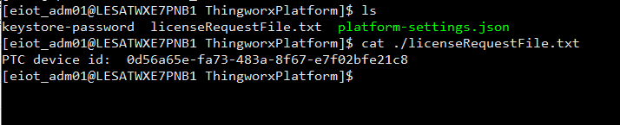
Thingworx 9.2 Install
3. Thingworx 설치
7. 톰캣 재시작
sudo systemctl restart tomcat
8. licenseRequestFile Device ID 확인
cat ./licenseRequestFile.txt

Slide 24
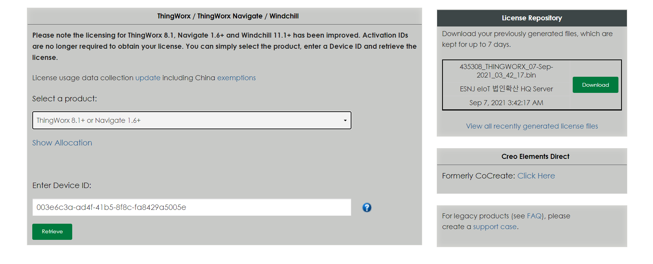
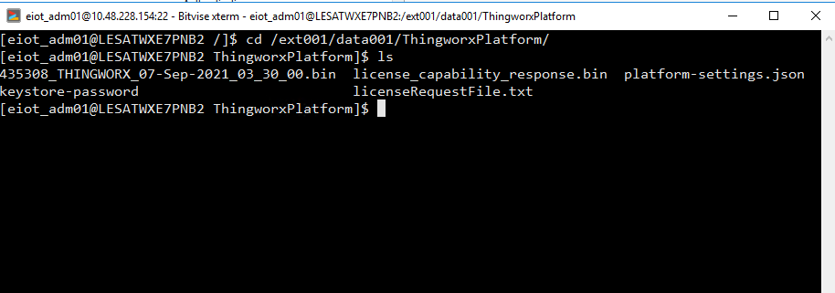
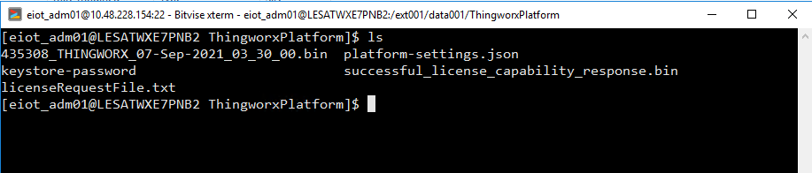
Thingworx 9.2 Install
3. Thingworx 설치
9. 라이선스 적용
sudo systemctl stop tomcat
mv 435308_THINGWORX_07-Sep-2021_03_30_00.bin /ext001/data001/ThingworxPlatform
cd /data001/ThingworxPlatform
cp 435308_THINGWORX_07-Sep-2021_03_30_00.bin license_capability_response.bin
sudo systemctl start tomcat
다운로드 후
ThingworxPlatform 폴더로으로 이동
확인한 Device ID 입력
라이선스 적용 전 확인
라이선스 적용 후 확인

Slide 25
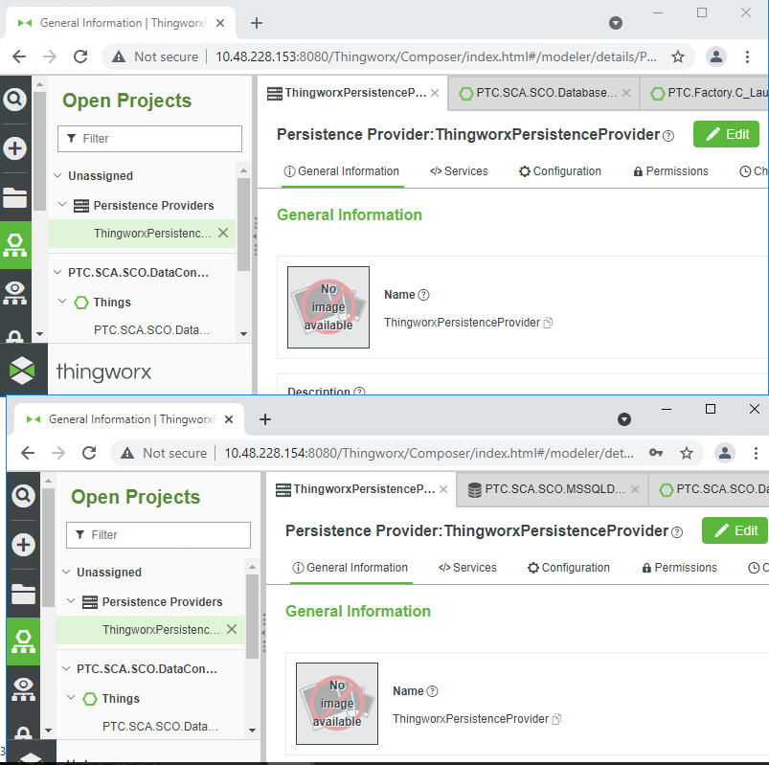
Thingworx 9.2 Install
3. Thingworx 라이선스 적용
첫번째 Server의 설정 파일을 복제한다.
첫번째 Server의 Tomcat Service를 종료한다. (10.48.228.153)
sudo systemctl stop tomcat
/ext001/data001/ThingworxPlatform 폴더를 Download하여 두번째 Server (10.48.228.154)에 업로드 한다.
이때, successful_license_capability_response.bin 파일명을 license_capability_response.bin로 변경한다.
cd /ext001/data001/ThingwroxPlatform
mv successful_license_capability_response.bin license_capability_response.bin
두번째 Server의 톰캣을 실행한다.
sudo systemctl start tomcat
첫번째 Server의 톰캣을 실행한다.
sudo systemctl start tomcat
라이선스 적용 전 확인
라이선스 적용 후 확인

Slide 26
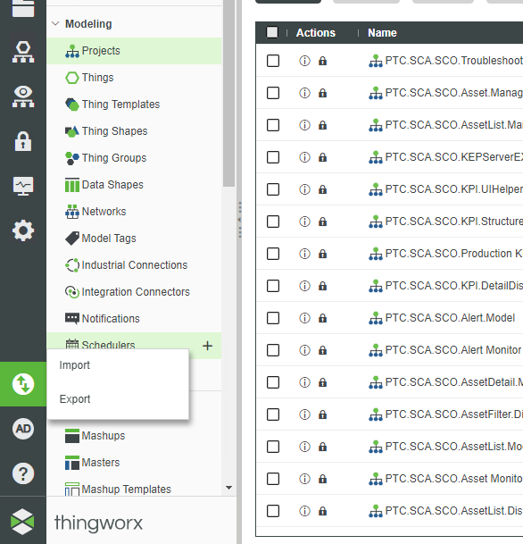
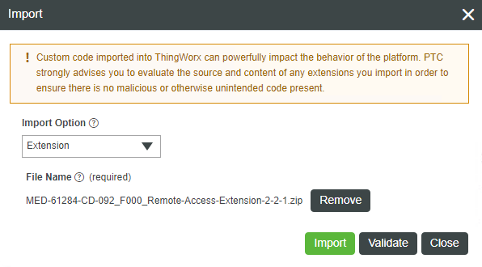
Thingworx 9.2 Install
3. Thingworx 설치
10. Manufacturing Extension
MED-61284-CD-092_F000_Remote-Access-Extension-2-2-1
ThingWorx-Apps-9.1.1-00-extension-dependencies
ThingWorx-Apps-9.1.1-00-extension
위 순서로 Import 진행
Import

Slide 27
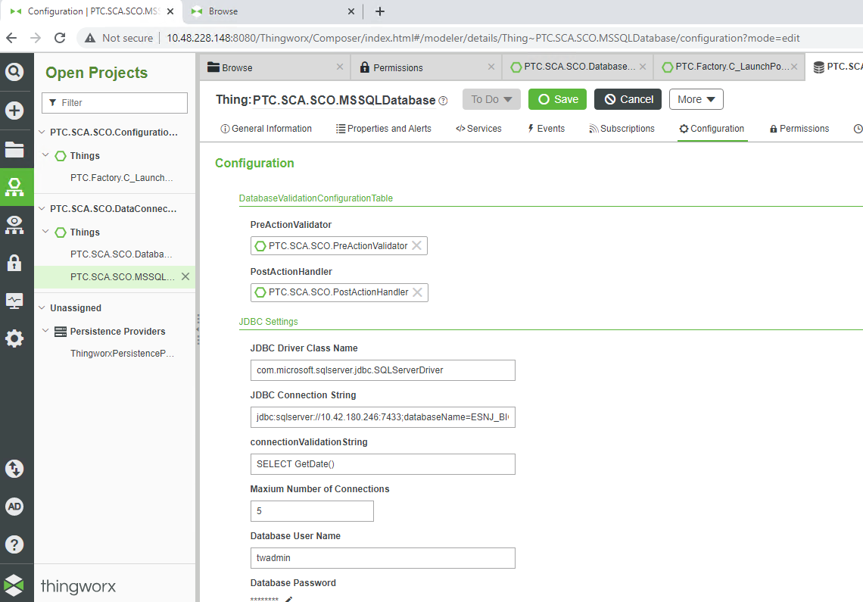
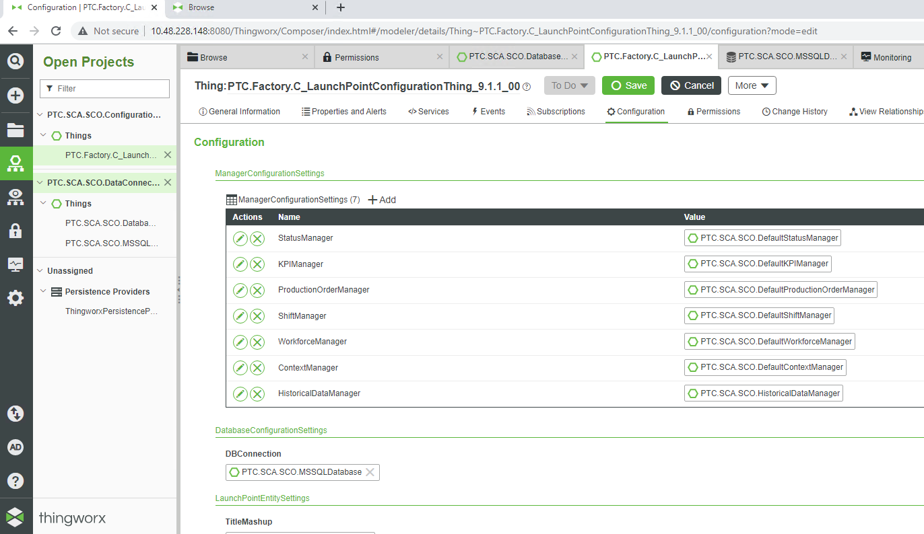
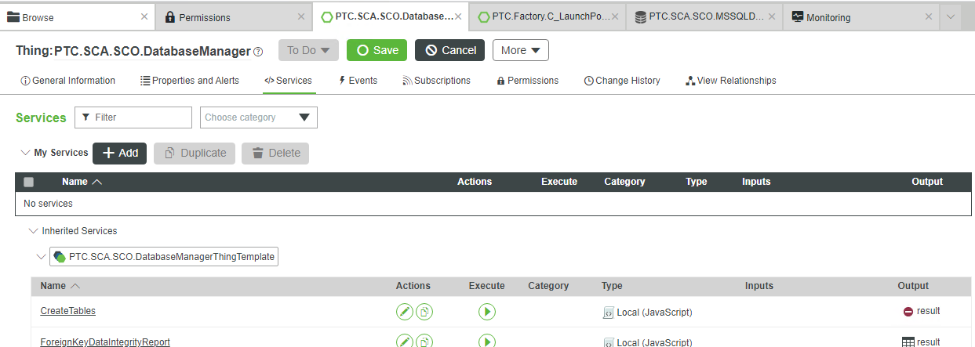
Thingworx 9.2 Install
3. Thingworx 설치
PTC.SCA.SCO.MSSQLDatabase -> Configuration에
JDBC Settings DB 정보 입력
PTC.Factory.C_LaunchPointConfigurationThing_9.1.1_00 0 -> Configuration에 DBConnections PTC.SCA.SCO.MSSQLDatabase 선택
PTC.SCA.SCO.DatabaseManager -> Services – CreateTable excute
DB 정보입력

Slide 28
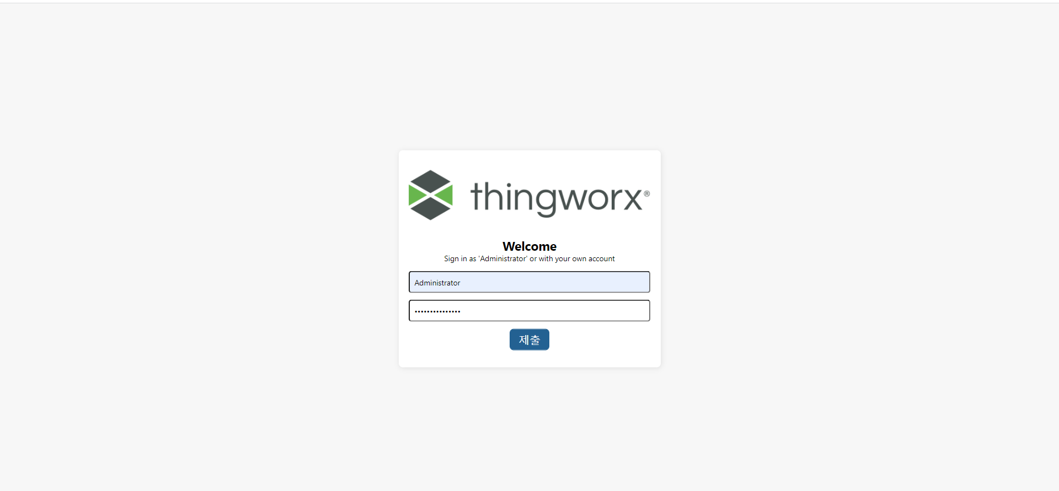
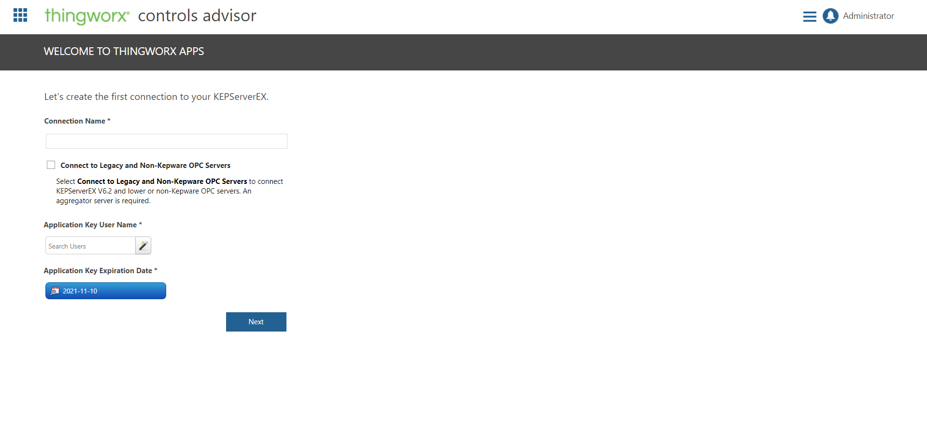
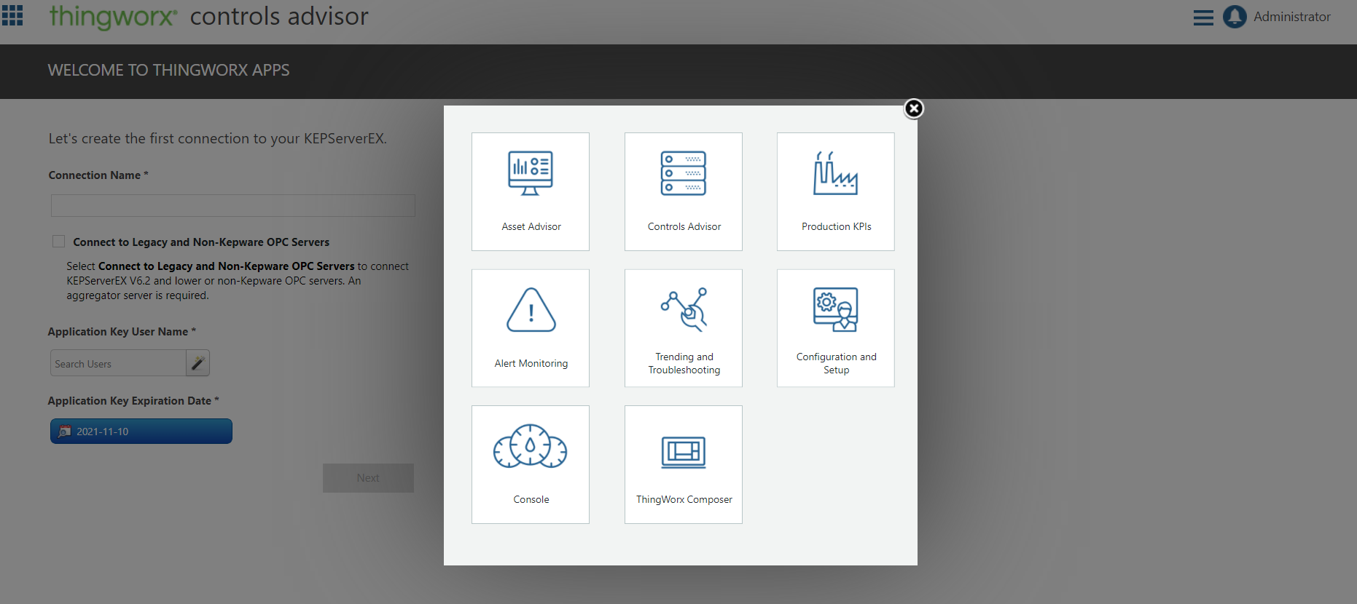
Thingworx 9.2 Install
3. Thingworx 설치
http://localhost:<port>/Thingworx/FormLogin/Welcome 접속
Administrator 로그인
왼쪽위 메뉴 선택 후 목록 8개 확인
클릭
8개 확인

Slide 29
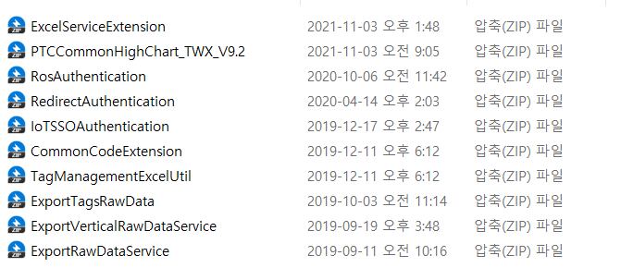
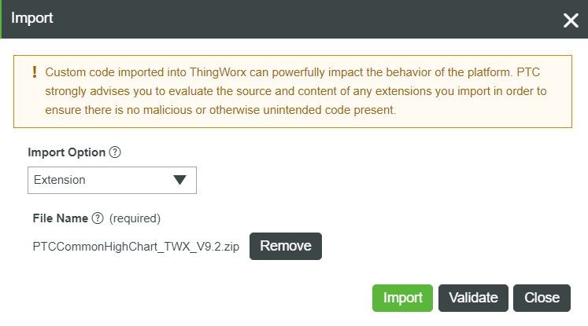
Thingworx 9.2 Install
3. Thingworx 설치
추가 Extension 목록
Import

Slide 30
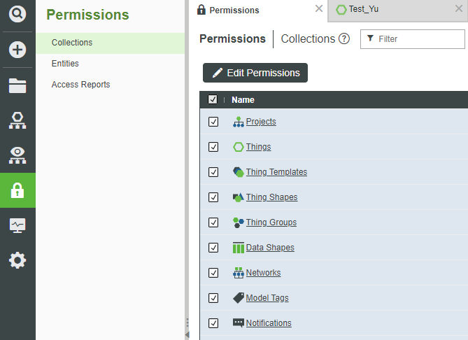
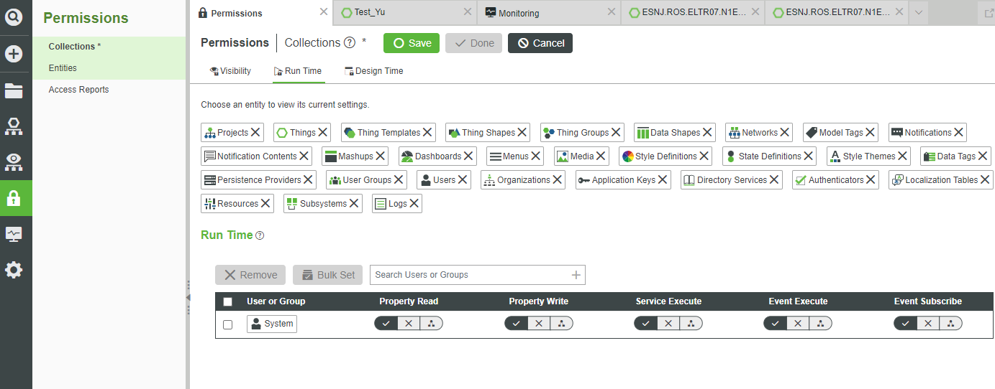
Thingworx 9.2 Install
3. Thingworx 설치
기본 권한 설정
System User는 ThingWorx의 시스템 개체임 이벤트,스크립트,서비스 내의 권한이 없는 Entity 접근 시 권한 적용됨 참고 URL : https://community.ptc.com/t5/IoT-Tech-Tips/The-use-of-System-User/td-p/533746
전체 체크박스 선택 후 Edit Permissions 선택
Run Time의 권한에 System을 설정 후 모든 권한을 허용 처리

Slide 31
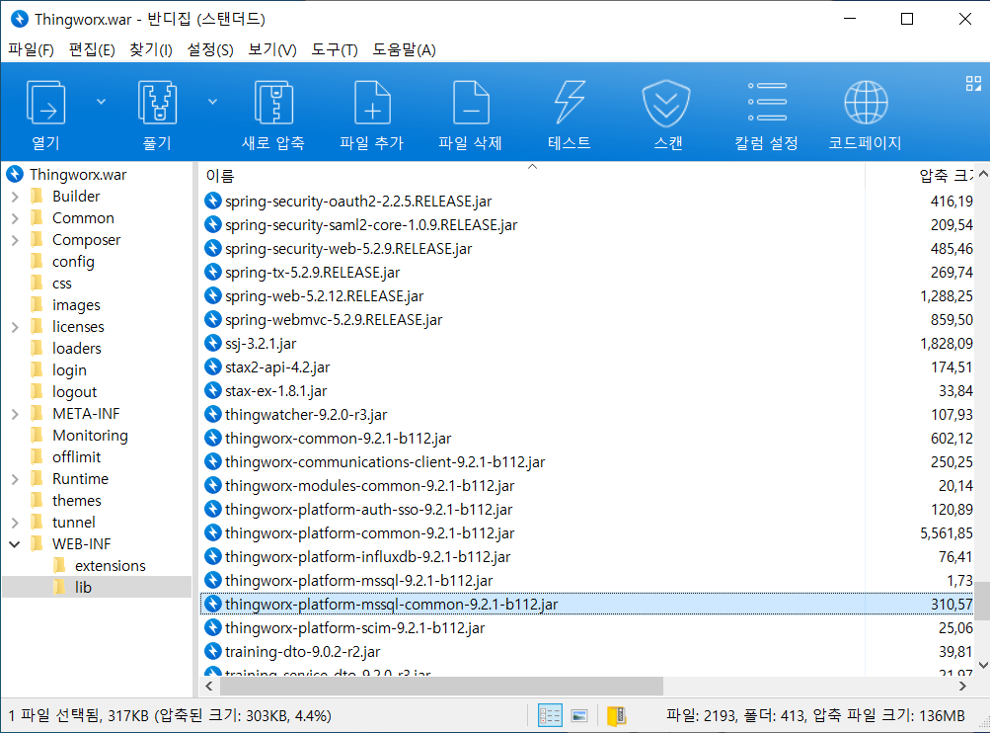
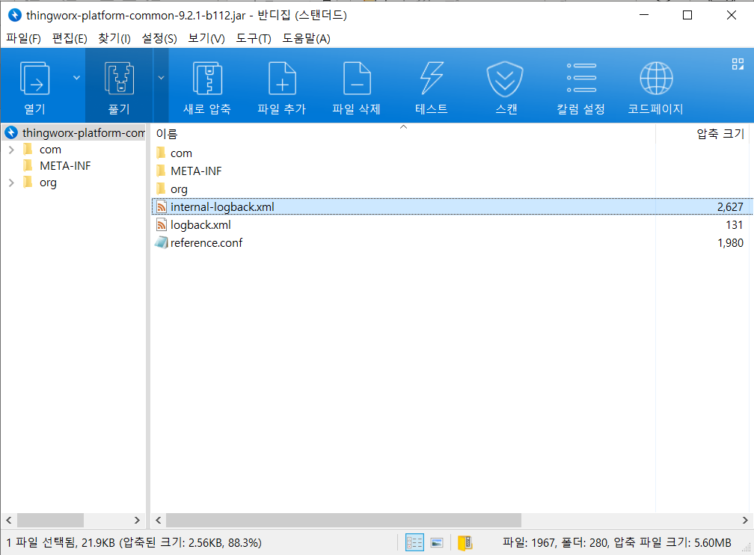
Thingworx 9.2 Install
3. Thingworx 설치 (선택사항)
Ignite logback 설정
1. Thingworx.war 파일안 thingworx-platform-common-9.2.1-b112.jar
을 압축 해제
2.thingworx-platform-common-9.2.1-b112.jar 안에 Internal-logback.xml 파일을 압축 해제
3. Internal-logback.xml 파일 수정

Slide 32
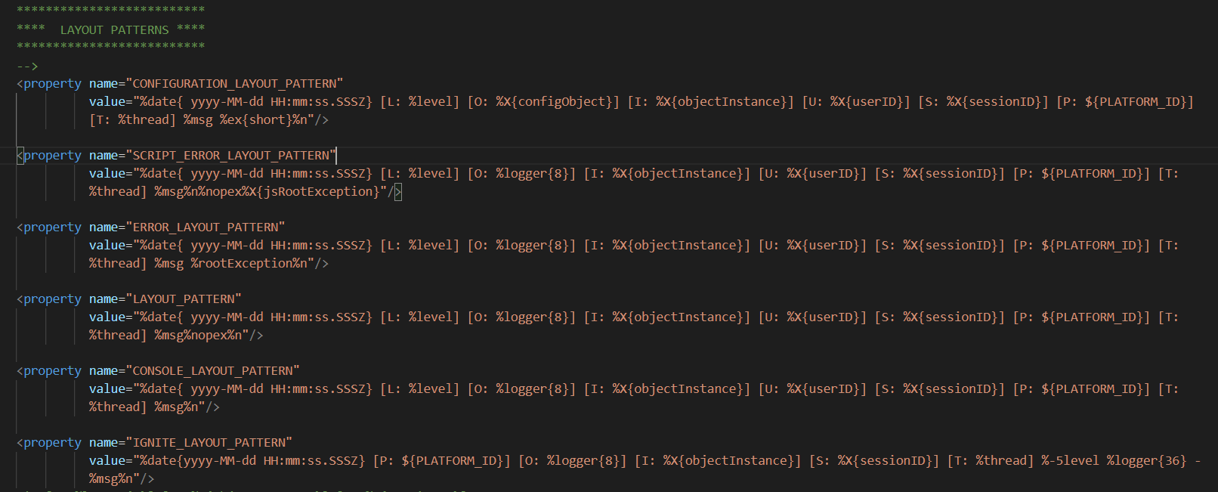
Thingworx 9.2 Install
3. Thingworx 설치 (선택사항)
Internal-logback.xml 파일 수정
LAYOUT PATTERNS에 Ignite에서 사용할 패턴추가
<property name="IGNITE_LAYOUT_PATTERN"
value="%date{yyyy-MM-dd HH:mm:ss.SSSZ} [P: ${PLATFORM_ID}] [O: %logger{8}] [I: %X{objectInstance}] [S: %X{sessionID}] [T: %thread] %-5level %logger{36} - %msg%n"/>

Slide 33
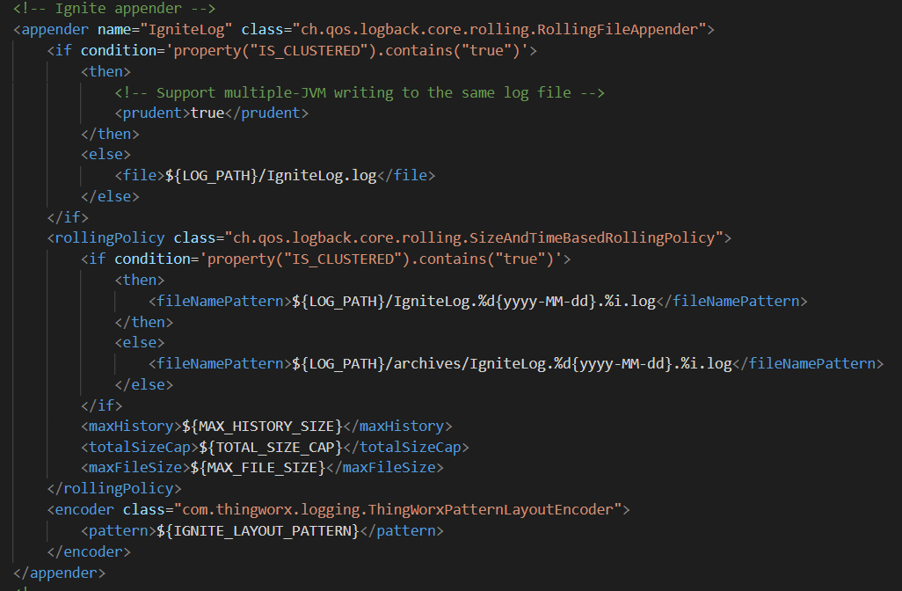
Thingworx 9.2 Install
3. Thingworx 설치 (선택사항)
Internal-logback.xml 파일 수정
APPENDER 에 Ignite에서 사용할 appender추가
<appender name="IgniteLog" class="ch.qos.logback.core.rolling.RollingFileAppender">
<if condition='property("IS_CLUSTERED").contains("true")'>
<then>
<!-- Support multiple-JVM writing to the same log file -->
<prudent>true</prudent>
</then>
<else>
<file>${LOG_PATH}/IgniteLog.log</file>
</else>
</if>
<rollingPolicy class="ch.qos.logback.core.rolling.SizeAndTimeBasedRollingPolicy">
<if condition='property("IS_CLUSTERED").contains("true")'>
<then>
<fileNamePattern>${LOG_PATH}/IgniteLog.%d{yyyy-MM-dd}.%i.log</fileNamePattern>
</then>
<else>
<fileNamePattern>${LOG_PATH}/archives/IgniteLog.%d{yyyy-MM-dd}.%i.log</fileNamePattern>
</else>
</if>
<maxHistory>${MAX_HISTORY_SIZE}</maxHistory>
<totalSizeCap>${TOTAL_SIZE_CAP}</totalSizeCap>
<maxFileSize>${MAX_FILE_SIZE}</maxFileSize>
</rollingPolicy>
<encoder class="com.thingworx.logging.ThingWorxPatternLayoutEncoder">
<pattern>${IGNITE_LAYOUT_PATTERN}</pattern>
</encoder>
</appender>

Slide 34
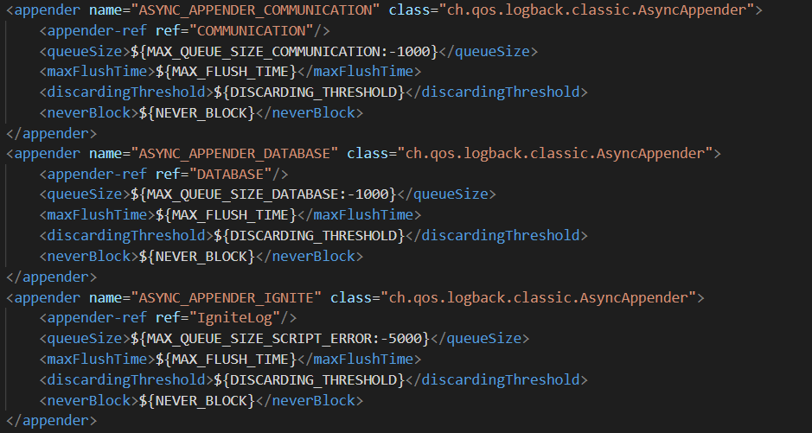
Thingworx 9.2 Install
3. Thingworx 설치 (선택사항)
Internal-logback.xml 파일 수정
Async appender 에 Ignite에서 사용할 appender추가
<appender name="ASYNC_APPENDER_IGNITE" class="ch.qos.logback.classic.AsyncAppender">
<appender-ref ref="IgniteLog"/>
<queueSize>${MAX_QUEUE_SIZE_SCRIPT_ERROR:-5000}</queueSize>
<maxFlushTime>${MAX_FLUSH_TIME}</maxFlushTime>
<discardingThreshold>${DISCARDING_THRESHOLD}</discardingThreshold>
<neverBlock>${NEVER_BLOCK}</neverBlock>
</appender>
ASYNC : 비동기 처리로 로그 쓰기

Slide 35
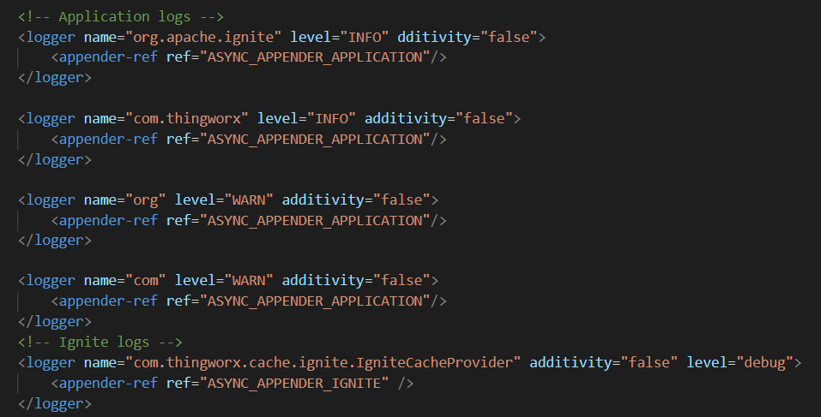
Thingworx 9.2 Install
3. Thingworx 설치 (선택사항)
Internal-logback.xml 파일 수정
LOGGERS에 Ignite에서 사용할 logger추가
<logger name="com.thingworx.cache.ignite.IgniteCacheProvider" additivity="false" level="debug">
<appender-ref ref="ASYNC_APPENDER_IGNITE" />
</logger>
additivity : 동시에 중복 로그 시 1개만 출력

Slide 36
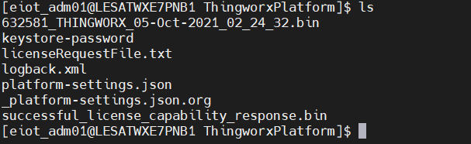
Thingworx 9.2 Install
3. Thingworx 설치 (선택사항)
Internal-logback.xml 파일명 변경 후 파일 이동
1. Internal-logback.xml -> logback.xml로 변경
2. /ext001/data001/ThingworxPlatform 으로 logback.xml 이동
3.tomcat 재시작
sudo systemctl restart tomcat
/ext001/data001/ThingworxStorage/logs/ 에 로그 쌓이는지 확인
ls /ext001/data001/ThingworxStorage/logs/ | grep 'IgniteLog*'

Slide 37
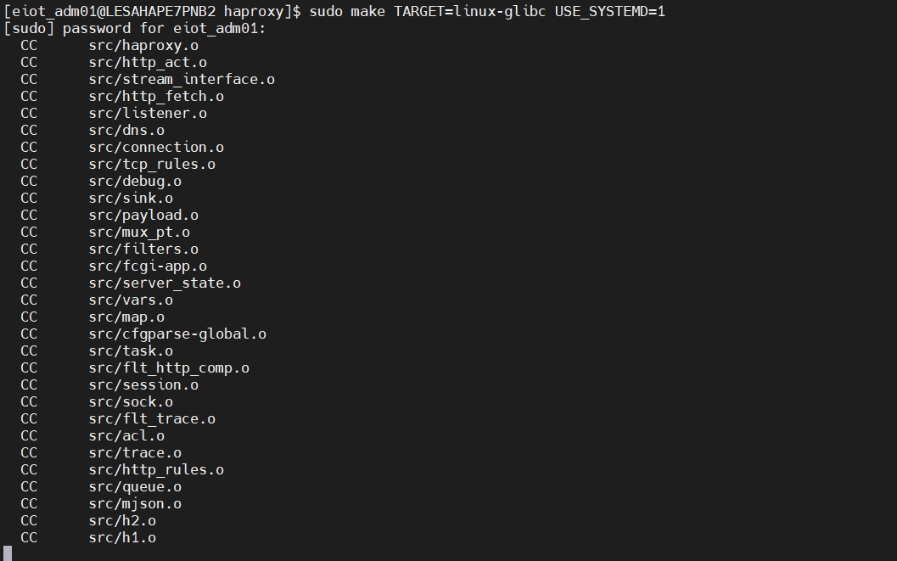
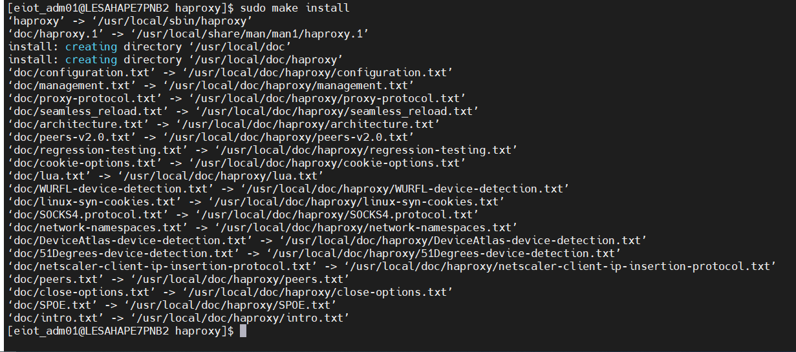

HAProxy Install
1. HAProxy MAKE
tar -zxvf haproxy-2.4.3.tar.gz
sudo mv haproxy-2.4.3 /haproxy
sudo yum install systemd-devel –y
sudo yum install gcc -y
cd /haproxy
sudo make TARGET=linux-glibc USE_SYSTEMD=1
./haproxy -vv | grep -i systemd
sudo make install

Slide 38

HAProxy Install
2. HAProxy 서비스 생성
sudo mkdir -p /run/haproxy
sudo vi /usr/lib/systemd/system/haproxy.service
Description=HAProxy Load Balancer
After=network.target
[Service]
EnvironmentFile=-/etc/default/haproxy
EnvironmentFile=-/etc/sysconfig/haproxy
Environment="CONFIG=/haproxy/haproxy.cfg" "PIDFILE=/run/haproxy.pid" "EXTRAOPTS=-S /run/haproxy-master.sock"
ExecStartPre=/haproxy/haproxy -f /haproxy/haproxy.cfg -c -q -S /run/haproxy-master.sock
ExecStart=/haproxy/haproxy -Ws -f /haproxy/haproxy.cfg -p /run/haproxy.pid -S /run/haproxy-master.sock
ExecReload=/haproxy/haproxy -f /haproxy/haproxy.cfg -c -q -S /run/haproxy-master.sock
ExecReload=/bin/kill -USR2 $MAINPID
KillMode=mixed
Restart=always
SuccessExitStatus=143
Type=notify
[Install]
WantedBy=multi-user.target

Slide 39

HAProxy Install
2. HAProxy.cfg 생성
sudo cd /haproxy
sudo vi haproxy.cfg
#---------------------------------------------------------------------
# Global settings
#---------------------------------------------------------------------
global
# setup logging and force level to debug. Logs require rsyslog be setup.
#chroot /var/lib/haproxy
#log /dev/log local0 debug
# maximum number of connections allowed
maxconn 10000
# turn on stats unix socket
stats socket /run/haproxy/admin.sock mode 660 level admin expose-fd listeners
stats timeout 30s
# user and group haproxy will run as
# user haproxy
# group haproxy
#---------------------------------------------------------------------
# common defaults that all the 'listen' and 'backend' sections will
# use if not designated in their block
#---------------------------------------------------------------------
defaults
default-server init-addr last,libc,none
log global
mode http
option httplog
option redispatch
option forwardfor
timeout connect 10s
timeout client 510s
timeout server 510s
timeout tunnel 1h
#---------------------------------------------------------------------
# FrontEnd Configuration
#---------------------------------------------------------------------
frontend ft_web
bind *:80 name web
# log the session cookie if passed
capture cookie JSESSIONID= len 32
## path based routing to connection server
#acl path_cxserver path -i-m beg /Thingworx/WS
#acl path_tunnelserver path -i-m beg /Thingworx/WSTunnelServer
#acl path_tunnelclient path -i-m beg /Thingworx/WSTunnelClient
#use_backend cxserver if path_cxserver or path_tunnelserver or path_tunnelclient
# default traffic to platform
default_backend platform
#---------------------------------------------------------------------
# BackEnd Platform Configuration
#---------------------------------------------------------------------
backend platform
balance roundrobin
# sticky sessions
cookie SERVER insert indirect nocache
http-request set-header X-Forwarded-Port %[dst_port]
#http-request add-header X-Forwarded-Proto https if { ssl_fc }
# health check
option httpchk GET /Thingworx/health
# configure platform instances
server platform1 10.48.228.153:8080 check inter 1000 fastinter 1000 cookie ESNJP71
server platform2 10.48.228.154:8080 check inter 1000 fastinter 1000 cookie ESNJP72
#---------------------------------------------------------------------
# BackEnd Connection Server Configuration
#---------------------------------------------------------------------
#backend cxserver
# balance source
#hash-type consistent
# option httpchk GET /
# configure connection server instances
# server cxserver1 10.0.10.20:8080 check port 9009
# server cxserver2 10.0.10.21:8080 check port 9009
#---------------------------------------------------------------------
#HAProxy Monitoring Config
#---------------------------------------------------------------------
listen stats
bind *:1936
mode http
option forwardfor
option httpclose
stats enable
stats uri /
stats refresh 5s
stats show-legends
stats realm Haproxy\ Statistics

Slide 40

HAProxy Install
3. HAProxy 서비스 시작 및 등록
sudo systemctl daemon-reload
sudo systemctl start haproxy
sudo systemctl status haproxy
sudo systemctl enable haproxy

Slide 41


KeepAlived Install
1.KeepAlived 설치
yum list | grep keepalived
sudo yum install keepalived -y
sudo vi /etc/sysctl.conf
net.ipv4.ip_nonlocal_bind=1
sudo sysctl -p

Slide 42

KeepAlived Install
1.KeepAlived 설정
cd /etc/keepalived/
sudo vi health-check.sh
sudo chmod 775 health-check.sh
#!/bin/sh
# HAProxy Service status check
if [ -z "`ps -eaf | grep haproxy | grep -v grep`" ];
then
exit 1
else
exit 0
fi

Slide 43




KeepAlived Install
1.KeepAlived 설정
sudo cp /etc/keepalived/keepalived.conf /etc/keepalived/keeplived.conf.org
ifconfig
sudo vi /etc/keepalived/keepalived.conf
global_defs {
}
# Define the script used to check if haproxy is still working
vrrp_script chk_haproxy {
script "/etc/keepalived/health-check.sh"
interval 2
fall 2
rise 2
}
vrrp_instance VI_1 {
state MASTER
interface ens192
virtual_router_id 152
priority 101
advert_int 1
authentication {
auth_type PASS
auth_pass 58myPass
}
virtual_ipaddress {
10.48.228.152
}
track_script {
chk_haproxy
}
}
Haproxy health-check 경로
MASTER 서버
BACKUP 서버
HA 그룹별
높을수록 우선순위
Vip 설정

Slide 44


KeepAlived Install
1.KeepAlived 설정
sudo systemctl start keepalived
sudo systemctl status keepalived
sudo systemctl enable keepalived
ip a

Slide 45
Installing a Connection Server
1. HA Proxy Server
- HA Proxy 설정에서 Connection Server 활성화를 위해 Config 파일을 수정한다.
Command
sudo vi /haproxy/haproxy.cfg
Source #2
sudo systemctl stop haproxy
sudo systemctl daemon-reload
sudo systemctl start haproxy
#---------------------------------------------------------------------
# FrontEnd Configuration
#---------------------------------------------------------------------
frontend ft_web
bind *:80 name web
# log the session cookie if passed
capture cookie JSESSIONID= len 32
## path based routing to connection server
acl path_cxserver path -i -m beg /Thingworx/WS
acl path_tunnelserver path -i -m beg /Thingworx/WSTunnelServer
acl path_tunnelclient path -i -m beg /Thingworx/WSTunnelClient
use_backend cxserver if path_cxserver or path_tunnelserver or path_tunnelclient
# default traffic to platform
default_backend platform
#---------------------------------------------------------------------
# BackEnd Platform Configuration
#---------------------------------------------------------------------
backend platform
balance roundrobin
# sticky sessions
cookie SERVER insert indirect nocache
http-request set-header X-Forwarded-Port %[dst_port]
#http-request add-header X-Forwarded-Proto https if { ssl_fc }
# health check
option httpchk GET /Thingworx/health
# configure platform instances
server platform1 10.31.253.16:8080 check inter 1000 fastinter 1000 cookie ESOCM01
Server platform2 10.31.253.17:8080 check inter 1000 fastinter 1000 cookie ESOCM02
#---------------------------------------------------------------------
# BackEnd Connection Server Configuration
#---------------------------------------------------------------------
backend cxserver
balance source
#hash-type consistent
option httpchk GET /
# configure connection server instances
server cxserver1 10.31.251.22:8080 check port 8081
server cxserver2 10.31.251.23:8080 check port 8081
#---------------------------------------------------------------------
#HAProxy Monitoring Config
#---------------------------------------------------------------------
listen stats
bind *:1936
mode http
option forwardfor
option httpclose
stats enable
stats uri /
stats refresh 5s
stats show-legends
stats realm Haproxy\ Statistics
Command
// 수정 완료 후 실행
설정 추가
주의 ) Path 후 옵션 공백 주의
-i-m (X) -> -i -m
Source #1
#---------------------------------------------------------------------
# Global settings
#---------------------------------------------------------------------
global
# setup logging and force level to debug. Logs require rsyslog be setup.
#chroot /var/lib/haproxy
#log /dev/log local0 debug
# maximum number of connections allowed
maxconn 10000
# turn on stats unix socket
stats socket /run/haproxy/admin.sock mode 660 level admin expose-fd listeners
stats timeout 30s
# user and group haproxy will run as
# user haproxy
# group haproxy
#---------------------------------------------------------------------
# common defaults that all the 'listen' and 'backend' sections will
# use if not designated in their block
#---------------------------------------------------------------------
defaults
default-server init-addr last,libc,none
log global
mode http
option httplog
option redispatch
option forwardfor
timeout connect 10s
timeout client 60s
timeout server 60s
timeout tunnel 1h
Connection Server 설정 추가
( IP , Port 정보는 설치 동에 맞게 수정 )

Slide 46
Installing a Connection Server
2. ThingWorx Platform Server
- Zookeeper, Connection Server 에서 명시적으로 ThingWorx Platform Server 를 확인하기 위해 Http Server Name 속성을 지정한다.
Command
sudo vi /usr/lib/systemd/system/tomcat.service
Command
sudo systemctl daemon-reload
sudo systemctl restart tomcat
// 수정 완료 후 실행
Source #1
[Unit]
Description=Apache Tomcat Web Application Container
After=network.target
[Service]
Type=forking
PIDFile=/var/run/tomcat.pid
Environment=THINGWORX_PLATFORM_SETTINGS=/ext001/data001/ThingworxPlatform
Environment=HTTP_PORT=8080
Environment=HTTP_SERVICE_NAME=thingworx-http
Environment=IGNITE_NO_SHUTDOWN_HOOK=true
Environment=IGNITE_WORK_DIR=/ext001/data001/ignite/work
Environment=CATALINA_PID=/var/run/tomcat.pid
Environment=JAVA_HOME=/usr/lib/jvm/java-11-amazon-corretto
Environment=CATALINA_HOME=/ext001/engn001/tomcat9.0/9.0.52
Environment=CATALINA_BASE=/ext001/engn001/tomcat9.0/9.0.52
Environment=CATALINA_OPTS=
ExecStart=/ext001/engn001/tomcat9.0/9.0.52/bin/jsvc \
-Dcatalina.home=${CATALINA_HOME} \
-Dcatalina.base=${CATALINA_BASE} \
-Djava.awt.headless=true -Djava.net.preferIPv4Stack=true -Dserver -XX:+UseNUMA \
-XX:+UseG1GC -Dfile.encoding=UTF-8 \
-Xms22000m \
-Xmx22000m \
-Djava.library.path=${CATALINA_BASE}/webapps/Thingworx/WEB-INF/extensions \
-cp ${CATALINA_HOME}/bin/commons-daemon.jar:${CATALINA_HOME}/bin/bootstrap.jar:${CATALINA_HOME}/bin/tomcat-juli.jar \
-user eiot_adm01 \
-java-home ${JAVA_HOME} \
-pidfile /var/run/tomcat.pid \
-errfile /ext001/data001/TomcatLogs/logs/catalina.out \
-outfile /ext001/data001/TomcatLogs/logs/catalina.out \
$CATALINA_OPTS \
org.apache.catalina.startup.Bootstrap
[Install]
WantedBy=multi-user.target

Slide 47


Installing a Connection Server
3. ThingWorx Platform Web
- 설치된 동의 ThingWorx Platform Web 에 접속하여 Connection Server 에서 사용될 Application Key를 생성 및 확인한다.
Web
http://xxx.xxx.xxx.xxx/Thingworx/Composer
// 설치될 동의 ThingWorx Platform URL
1. Browse -> Application Keys -> New 를 클릭하여 새로운 Application Key를 생성한다.
3
1
2. 아래와 같이 정보를 입력한다.
Name : Connection Server
Project : PTCDefaultProject
User Name Reference : Administrator
해당 Key 를 확인한다.
2
종료일을 2200-12-31로 지정한다.

Slide 48

Installing a Connection Server
4. Connection Server
OpenJDK 설치 (sudo rpm -i java-11-amazon-corretto-devel-11.0.12.7-1.x86_64.rpm )
PTC 에서 Connection Server 의 설치 파일을 다운받아 서버에 설정한다.
다운로드 : https://support.ptc.com/appserver/auth/it/esd/product.jsp?prodFamily=TWC
해당 가이드에서는 connection-server-9.2.0.1 버전을 설치하였으며, Path 는 /var/opt/connection-server-9.2.0.1 로 지정한다. ( PTC 가이드 참조 )
1
권한으로 인해 Connection Server File 이 업로드가 안될 때
/home/eiot_adm01/Files/ 에 connection-server-9.2.0.1 폴더 업로드
아래의 명령어를 통해 폴더 복사
sudo scp -rp /home/eiot_adm01/Files/connection-server-9.2.0.1 /var/opt/
2
Check 사항
설치 동의 ThingWorx Platform 의 Application Key 정보 확인
설치 동의 Zookeeper 의 Port 확인
sudo vi /ext001/data001/ThingworxPlatform/platform-settings.json

Slide 49
Installing a Connection Server
4. Connection Server
Connection Server 에 설치 파일을 정상적인 경로에 업로드 후 아래와 같이 진행한다.
Path : /var/opt/connection-server-9.2.0.1
Command
sudo vi /var/opt/connection-server-9.2.0.1/conf/cxserver.conf
// 새로운 Config 파일 설정
Source #1
// 전체 입력
cx-server {
transport {
websockets {
app-key = "51a3c0fc-055b-4eb0-a45e-3d3d55ced1b5"
service-discovery {
enabled = true
tls-enabled = false
service-name="thingworx-http"
}
connections {
verifyHostName = false
}
}
}
discovery {
connectionString = "10.31.251.8:2185,10.31.251.9:2185,10.31.251.10:2185“
}
health-check.port = 8081
protocol {
port = 8080
http-server {
ssl {
enabled = false
}
key-store {
file = null
password = null
}
}
http-client {
ssl {
verify-host = false
}
}
websockets {
auth-request-timeout = 10s
}
}
platform.transport = "websockets_active_active"
}
ThingWorx Platform 의 Application Key 입력
법인의 Zookeeper 의 Instance 설정
- 설치 동의 IP , Port 입력

Slide 50


Installing a Connection Server
4. Connection Server
Connection Server 의 환경 변수를 설정한다.
Command
sudo vi /etc/environment
// 새로운 Config 파일 설정
Source #1
// 전체 입력
export JAVA_HOME=/usr/lib/jvm/java-11-amazon-corretto
export CONNECTION_SERVER_OPTS="-Dconfig.file=/var/opt/connection-server-9.2.0.1/conf/cxserver.conf -Dlogback.configurationFile=/var/opt/connection-server-9.2.0.1/conf/ogback.xml"
Command
// 환경 변수 설정 완료
source /etc/environment
sudo chmod +x /var/opt/connection-server-9.2.0.1/bin/connection-server
// 권한 설정
Command
sudo /var/opt/connection-server-9.2.0.1/bin/connection-server
// 실행
Check
// Connection Server 의 정상 적인 출력
// Connection Server 의 health-check Port 를 이용하여 확인 가능
Connection Server IP 및 설정된 Port 이용

Slide 51

Installing a Connection Server
4. Connection Server
정상적으로 Connection Server 를 설치 및 구동하여 ThingWorx Platform 에서 연결 정보를 확인 할 수 있다.
Check
1. Monitoring -> Connection Servers
// Connection Server 의 정상 적인 출력
// 두 개의 Connection Server 가 Alwayson 으로 표시 되어야 함

Slide 52
Installing a Connection Server
5. Connection Server Service
Connection Server 설치가 완료되면 Serivce 로 등록하여 자동 시작할 수 있도록 한다.
Command
vi /var/opt/connection-server-9.2.0.1/bin/connection-server-start.sh
// Connection Server Start Service
Source #1
// 전체 입력
#!/bin/bash
export BIN_PATH=/var/opt/connection-server-9.2.0.1/bin
if [ -z "`ps -eaf | grep java| grep connection-server`" ];
then
echo "connection-server start"
sudo ${BIN_PATH}/connection-server &
else
sudo echo "connection-server already start"
fi
Command
vi /var/opt/connection-server-9.2.0.1/bin/connection-server-stop.sh
// Connection Server Stop Service
Source #2
// 전체 입력
#!/bin/bash
export BIN_PATH=/var/opt/connection-server-9.2.0.1/bin/
if [ -n "`ps -eaf | grep java| grep connection-server`" ];
then
sudo kill -9 `ps -ef |grep java | grep connection-server| awk '{print $2}'`
echo "connection-server stop"
fi
Command
cd /var/opt/connection-server-9.2.0.1/bin
sudo chmod 755 connection-server-start.sh connection-server-stop.sh
// Service 권한 설정

Slide 53
Installing a Connection Server
5. Connection Server Service
Connection Server 설치가 완료되면 Serivce 로 등록하여 자동 시작할 수 있도록 한다.
Command
sudo vi /etc/init.d/connection-server
Source #3
// 전체 입력
#!/bin/sh
#
# chkconfig: - 80 05
# description: connection-server
#
BIN_PATH=/var/opt/connection-server-9.2.0.1/bin/
case $1 in
start) sudo ${BIN_PATH}/connection-server-start.sh ;;
stop) sudo ${BIN_PATH}/connection-server-stop.sh ;;
*) echo "require start|stop"
esac
Command
cd /etc/init.d
sudo chmod +x connection-server
sudo chkconfig --add connection-server
sudo chkconfig connection-server on
sudo service connection-server start
sudo service connection-server stop ( 종료 )

Slide 54
VisualVM Remote 설정
2. ThingWorx Platform Server (선택사항)
Source #1
Command
sudo vi /usr/lib/systemd/system/tomcat.service
[Unit]
Description=Apache Tomcat Web Application Container
After=network.target
[Service]
Type=forking
PIDFile=/var/run/tomcat.pid
Environment=THINGWORX_PLATFORM_SETTINGS=/ext001/data001/ThingworxPlatform
Environment=HTTP_PORT=8080
Environment=HTTP_SERVICE_NAME=ESOCA01
Environment=IGNITE_NO_SHUTDOWN_HOOK=true
Environment=IGNITE_WORK_DIR=/ext001/data001/ignite/work
Environment=CATALINA_PID=/var/run/tomcat.pid
Environment=JAVA_HOME=/usr/lib/jvm/java-11-amazon-corretto
Environment=CATALINA_HOME=/ext001/engn001/tomcat9.0/9.0.52
Environment=CATALINA_BASE=/ext001/engn001/tomcat9.0/9.0.52
Environment=CATALINA_OPTS=
ExecStart=/ext001/engn001/tomcat9.0/9.0.52/bin/jsvc \
-Dcatalina.home=${CATALINA_HOME} \
-Dcatalina.base=${CATALINA_BASE} \
-Djava.awt.headless=true -Djava.net.preferIPv4Stack=true -Dserver -XX:+UseNUMA \
-XX:+UseG1GC -Dfile.encoding=UTF-8 \
-Xms22000m \
-Xmx22000m \
-Djava.library.path=${CATALINA_BASE}/webapps/Thingworx/WEB-INF/extensions \
-cp ${CATALINA_HOME}/bin/commons-daemon.jar:${CATALINA_HOME}/bin/bootstrap.jar:${CATALINA_HOME}/bin/tomcat-juli.jar \
-user eiot_adm01 \
-java-home ${JAVA_HOME} \
-pidfile /var/run/tomcat.pid \
-errfile /ext001/data001/TomcatLogs/logs/catalina.out \
-outfile /ext001/data001/TomcatLogs/logs/catalina.out \
-Dcom.sun.management.jmxremote=true \
-Dcom.sun.management.jmxremote.port=9010 \
-Dcom.sun.management.jmxremote.rmi.port=9010 \
-Dcom.sun.management.jmxremote.local.only=false \
-Dcom.sun.management.jmxremote.authenticate=false \
-Dcom.sun.management.jmxremote.ssl=false \
-Djava.rmi.server.hostname=10.31.253.13 \
$CATALINA_OPTS \
org.apache.catalina.startup.Bootstrap
[Install]
WantedBy=multi-user.target
Command
sudo systemctl daemon-reload
sudo systemctl restart tomcat
// 수정 완료 후 실행
Command
netstat -nap | grep 9010
// LISTEN 확인
VisualVM Remote 설정

Slide 55

Tomcat Service Check 및 자동실행
1. Shell 파일 생성
cd /ext001/data001/TomcatLogs
vi autoRestartTomcat.sh
chmod 775 autoRestartTomcat.sh
#!/bin/bash
export JAVA_HOME=/usr/lib/jvm/java-11-amazon-corretto
export PATH=$PATH:$JAVA_HOME/bin
export CATALINA_HOME=/ext001/engn001/tomcat9.0/9.0.52
export PATH=$PATH:$CATALINA_HOME/bin
export END_TIME=`date +%m/%d' '%H:%M:%S`
if [ -z "`ps -eaf | grep java| grep tomcat`" ];
then
echo '@p@ssw0rd#$' | sudo -S systemctl restart tomcat
echo "["$END_TIME"] Tomcat restart.."
Fi
TWX 서버 접속계정 비밀번호 변경 시 동일하게 변경 후 서비스 재시작

Slide 56

Tomcat Service Check 및 자동실행
2. Crontab 설정
sudo crontab -e
*/1 * * * * /ext001/data001/TomcatLogs/autoRestartTomcat.sh >> /ext001/data001/TomcatLogs/logs/tomcat_restart.log 2>&1
sudo /sbin/service crond restart

Slide 57
서비스 실행 및 확인
서비스 실행 순서
전체 서버를 재기동 하는 경우
# Zookeeper -> Tomcat -> HAProxy -> Keepalived 순서대로 서비스를 실행한다.
Zookeeper
Tomcat
$ service zookeeper-server start
$ service zookeeper-server stop
$ service zookeeper-server status
$ service zookeeper-server restart
$ sudo systemctl start tomcat
$ sudo systemctl stop tomcat
$ sudo systemctl status tomcat
$ sudo systemctl restart tomcat
HAProxy
Keepalived
$ sudo systemctl start haproxy
$ sudo systemctl stop haproxy
$ sudo systemctl status haproxy
$ sudo systemctl start keepalived
$ sudo systemctl stop keepalived
$ sudo systemctl status keepalived

